Slide 1
General Paediatrics 1
Fabrizio Pecoraro

Slide 2
The quality of child healthcare: a comparison among 30 European countries
Fabrizio Pecoraro¹, Ilaria Rocco², Oscar Tamburis¹,
Barbara Corso², Nadia Minicuci², Daniela Luzi¹
¹ National Research Council, Institute for Research on Population and Social Policies, Rome, Italy
² National Research Council, Neuroscience Institute, Padua, Italy

Slide 3
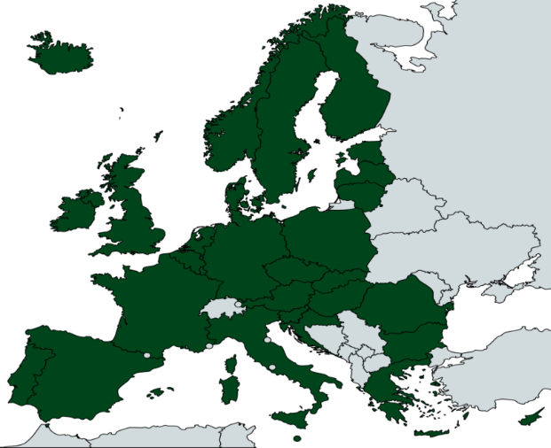
The MOCHA project: Aim
To compare and appraise existing models of primary care
for children among 30 EU/EEA countries
On a wide range of child care topics:
Primary care
Complex care
School health services
Quality of care assessment
Economic and skills analysis
Equity
Use of Electronic health records

Slide 4
Background
Different International Organization (WHO, OECD, EU) have set the principles on which child health care should be based and the need for monitoring activities to evaluate their fulfilments
Despite differences in the selections of quality measures, specific areas of concern are emerging as well as the necessity of a life-course approach
However
Monitoring the progress achieved by each country to improve child health care is under investigated
Little is known about the routine adoption of measures by national/regional health assessment agencies
This is particularly true considering paediatric care
Notes:
Starting from the United Nations declaration of children’s rights [5] to the strategy most recently developed by the WHO Regional Office for Europe for the period 2015-2020 [6], these initiatives have the merit to have set the principles on which child health care should be based as well as the need for monitoring activities to evaluate their fulfilments.
Despite differences in priority settings that influence the selections of quality measures [7] [8], specific areas of concern are emerging such as those taking into account changes in epidemiology [9], socio-economic and educational factors that affect child health [4] as well as the necessity of having a life-course approach in the evaluation of child health care [5].
However, monitoring the progress achieved by each country that has signed international conventions and/or have adopted international strategies to improve child health care is under investigated [10] [11].
Moreover, little is known about the routine adoption of measures by national/regional health assessment agencies [12], or on the operational issues and policies arising from the implementation of health care systems’ evaluation [13],
not to mention that those analyses very rarely [14] consider paediatric quality measures.

Slide 5
Methodology: Data collection
Agencies in charge of the evaluation of quality of child care at national and/or local level
  27 CAs responded to the questionnaire
  23 CAs reported having a system in place
Measures adopted to assess the quality of childcare
  872 measures reported in total (307 directly; 565 from documents)
  352 measures excluding duplicates
Preliminary results were sent back to CAs to check, update and clarify potential ambiguities
Notes:
A questionnaire was sent to CAs to:
Explore the presence of agencies/organizations in charge of the evaluation of quality of care at national and/or local level distinguishing between agencies that have a specific part devoted to child health care, or include child health related items within the national/local general quality assessment.
If an agency/organization was reported, the questionnaire sought a list of all measures used to evaluate the quality of child health care along with any other official documents (e.g. policy document and/or assessment report) as well as links to websites of government bodies and to scientific works. All these materials were thoroughly examined in order to identify further measures that did not appear otherwise in the questionnaire.
Criteria to exclude duplicate measures were based on the description of each measure and the extent to which their descriptions would have provided equal or equivalent information. A typical example of it is the differences in the distribution units (e.g. by 1000 or 100000 population).
The preliminary results of the analysis of the questionnaires were sent back to the CAs who were asked to check, update and clarify potential ambiguities.

Slide 6
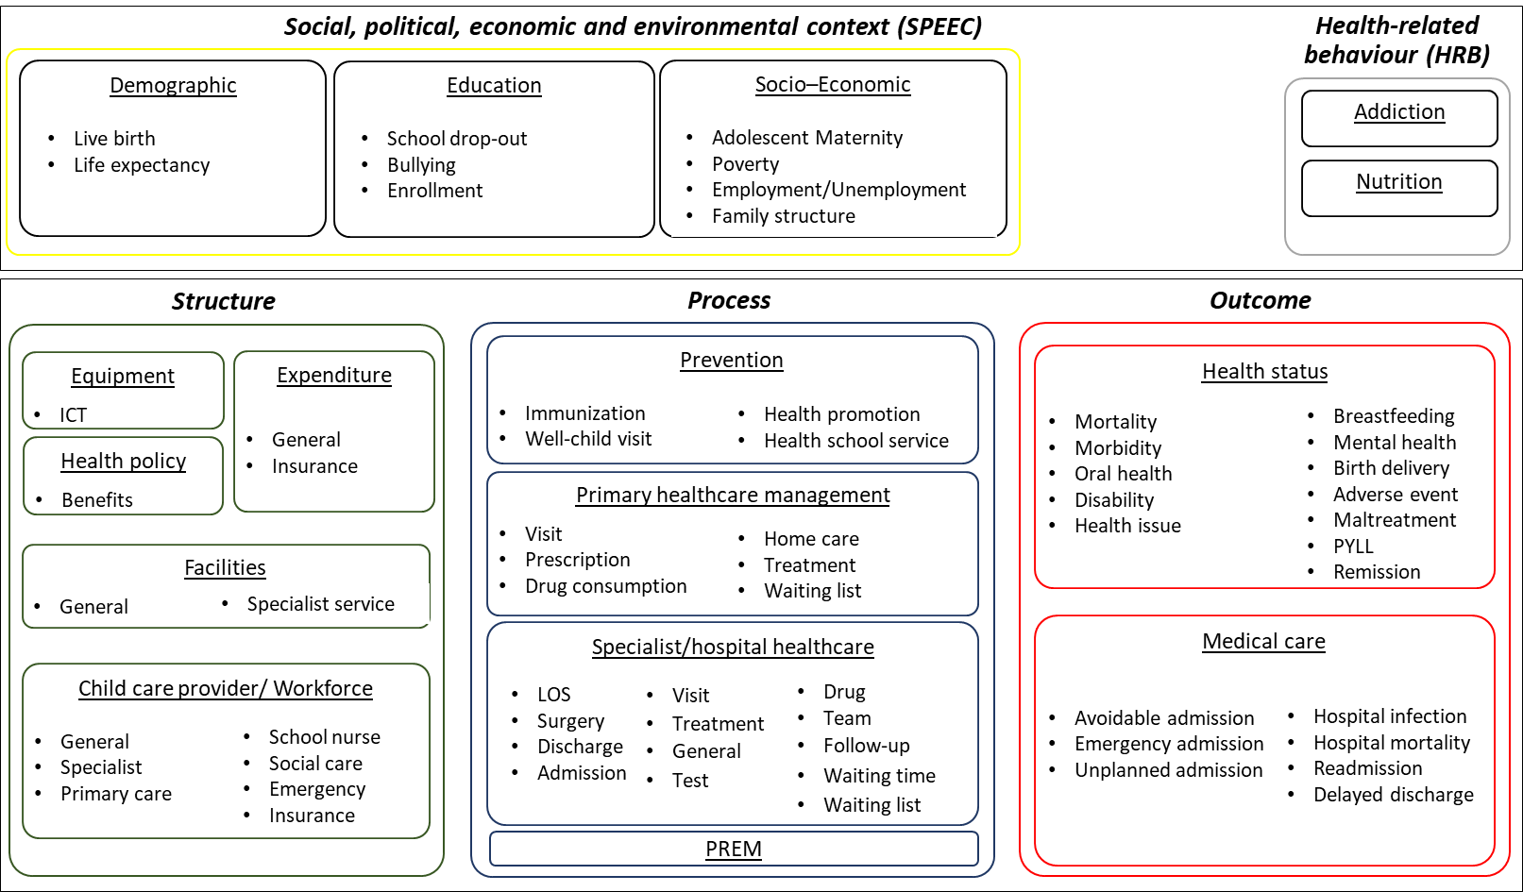
Methodology: Conceptual Map
Notes:
5 domains
16 topics (THEMES)
67 sub-topics (ASPECTS)
352 measures
The resulting map depicts the main areas of concerns, that is the domains that group at high level measures related with non-medical determinants of health (Social, political, economic context /TOLTO environment; Health-related behaviour) and those more closely connected with health system performance indicators, traditionally based on the Donabedian framework (Structure, Process and Outcome). The refinement of the five domains outlines 15 themes (hereafter categories??) that are further detailed in 67 related aspects (sub-categories), which already show a broad range/spectrum of perspectives differently used to assess child health care.
All collected measures underwent a process of classification, combining top-down and bottom-up approaches through an iterative analysis, as described in [20] [21]. This produced a conceptual map composed at high level by five domains (Social, political, economic, and environmental context – SPEEC; Health-related behaviour – H-RB; Structure; Process; and Outcome) that expands the Donabedian framework [22], including child’s crucial aspects related to non-health determinants [4]. Based on the measures available, each domain was further detailed in a two-level hierarchy that homogeneously groups the variety of measures, facilitates the comparison across countries and helps outlining the breadth of child-centred evaluation of health care. In total 67 sub-categories were identified grouping 352 measures.
Among the 27 CAs that completed the questionnaire, the CAs of Greece and Malta reported to have no agency for the evaluation of the quality in primary health care, while the CAs of Poland and Romania indicated that the assessment of their health care systems is carried out using health care accreditation procedures, based on the functioning of hospitals and primary health care as well as specialist outpatient care and treatment of addictions. France, Luxembourg and Slovakia representatives did not reply. The remaining 23 countries reported having a system in place and provided a total of 352 measures adopted for the evaluation of the quality of health care for children. Among the 23 countries that have agencies, 12 of them devote a specific part of the quality assessment to child health care, while the other countries integrate some child specific items within their health system evaluation [20].
352 measures were classified on the basis of a two-level hierarchical map of domains that allowed the analysis on the breadth/multidimensionality of child-centred evaluation of health care.
Moreover, the analysis of breadth and frequency of use of measures adopted by national/regional health assessment agencies outlined a high variability across countries within a sparse distribution of measures used to analyse different aspects of the quality of child health care.

Slide 7
Aim of our work
Determine the level of convergence in the use of common measures to investigate the prevailing aspects of child quality of care
Detect specificities that may shed light to a multi-dimensional approach of the evaluation of child health care
Sparsity Index
Investigate the coverage of child age ranges to capture the level of child invisibility
Analyse and compare practices
providing insights on the priority posed in each country

Slide 8
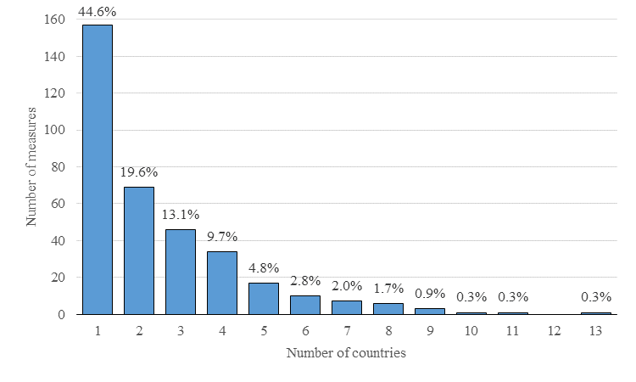
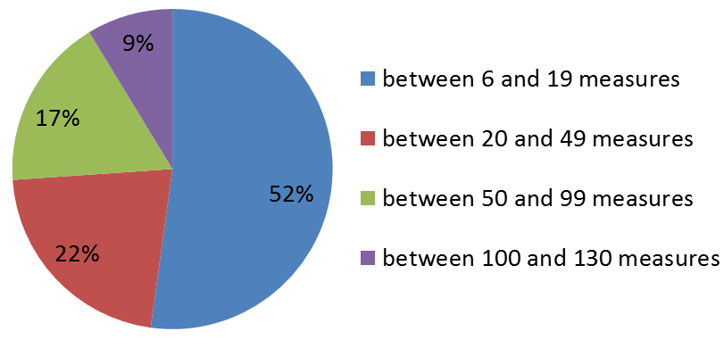
Results: Quantity and distribution of measures
lack of common measures of
children’s health care quality in Europe
amount of measures is not
equally distributed across countries
Iceland = 6 measures
UK = 130 measures
Immunization rates/coverage
Infant Mortality per 1.000 live birth
Number of live births
Notes:
As shown in Figure 1, the distribution of these measures, by the number of countries reporting each of them, highlights that the majority (44.6%) of the measures is reported by only one country. The measures reported by two countries are less than 20%, while the ones reported by at least three countries are about 36%. This graphically highlights the worrying lack of common measures of children’s health care quality in Europe.

Slide 9
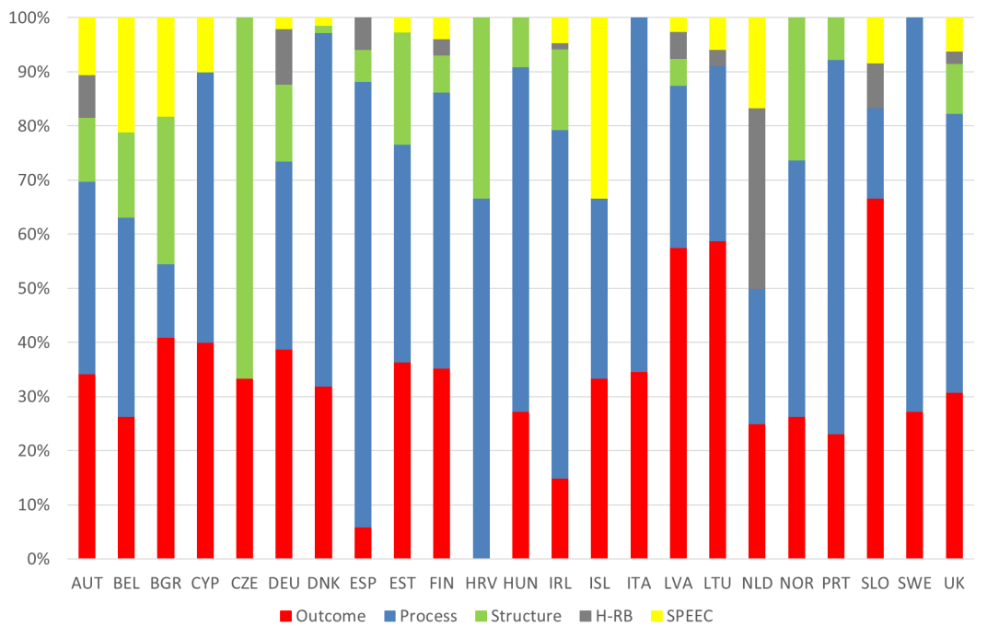
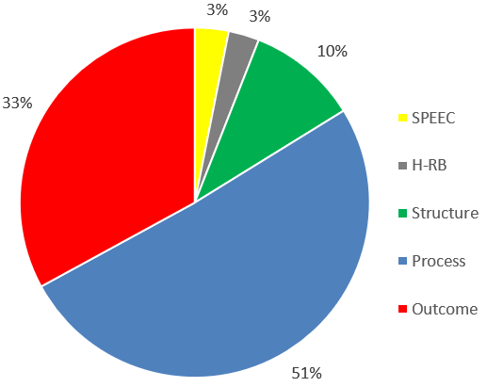
Results: Quantity and distribution of measures
the overall tendency is to privilege process, outcome and structure domains
differences across countries can be detected
Notes:
1) the overall tendency is to privilege measures classified in the process (50.7%), outcome (33.0%) and structure (10.3%) domains, while country evaluation of non-medical determinants of health is rarely accomplished (respectively 3.1% and 2.9% for SPEEC and HR-B domains). This tendency could be explained considering that national/regional health evaluation agencies generally rely on in a well-established administrative data flow generally aiming at cost control that traditionally refer to the Donabedian framework.
2) However, within this tendency variations among countries are worth noting.
Czech Republic is country where 67.7% of measures are related to structure,
The wide adoption of measures related to process varies consistently from the Spanish highest proportion of measures (82.4%) to the lowest one in Bulgaria (13.6%).
Iceland (33.3%) has the highest percentage of measures related to SPEEC domain, while the Netherlands is the country with the highest percentage of H-RB measures (33.3%).
Important to consider is that six countries (Austria, Germany, Finland, Ireland, Latvia and UK) cover all the domains of the map suggesting efforts toward a multi-dimensional evaluation of child care.

Slide 10


Results: Frequency of measures’ adoption
 | # Sub-cat | SI Sub-cat | # Measures | SI Measures |  |  | # Sub-cat | SI Sub-cat | # Measures | SI Measures
GBR | 49 | 7,4 | 130 | 4,2 |  | BEL | 15 | 10,7 | 19 | 5,2
FIN | 36 | 8,8 | 102 | 4,5 |  | NOR | 15 | 9,7 | 19 | 4,6
IRL | 36 | 7,9 | 87 | 4,1 |  | HRV | 12 | 9,5 | 18 | 4,2
EST | 34 | 8,2 | 77 | 4,5 |  | ESP | 8 | 11,1 | 17 | 2,4
AUT | 34 | 8,1 | 76 | 4,7 |  | PRT | 10 | 11,1 | 13 | 3,5
DNK | 25 | 8,2 | 72 | 1,4 |  | NLD | 10 | 10,3 | 12 | 5,0
DEU | 25 | 9,5 | 49 | 4,0 |  | SLO | 8 | 11,4 | 12 | 3,7
LVA | 20 | 9,9 | 40 | 3,4 |  | HUN | 9 | 10,6 | 11 | 3,4
LTU | 15 | 10,7 | 34 | 4,9 |  | SWE | 7 | 10,6 | 11 | 2,7
ITA | 9 | 11,4 | 26 | 4,2 |  | CYP | 8 | 12,6 | 10 | 6,8
BGR | 11 | 10,5 | 22 | 5,4 |  | CZE | 7 | 7,6 | 9 | 2,6
 |  |  |  |  |  | ISL | 4 | 13,0 | 6 | 5,2
$$SI=\frac{\sum_{i=1}^{k}{n_{i}}}{k}$$
k: # measures adopted by the country
$n_{i}$: # countries adopting the i-th measure
Notes:
Varietà nella specificità …
To determine the level of diffusion of the measures adopted by each country …
most of the measures are used by a limited number of countries, while only a restricted number of measures are adopted by a relatively higher number or countries
Note that the sparsity index is not necessarily correlated either with the number of measures or with the number of country’s singularly-adopted measures, confirming a heterogeneous vision in the evaluation of child care.
The sparsity index varies between 1.4 computed over the 72 measures adopted by Denmark to 6.8 of the 10 measures reported by Cyprus. The analysis of these two extremes sheds light on two different trends in the evaluation of child care. On the one hand, Denmark provides an example of the use of a consistent number of measures focused on specific aspects that are not considered by other countries. In particular, 62 measures (86%) are exclusively used by this country and the other 8 (11%) are shared with at most other four countries. The remaining two measures are reported by another six and seven countries respectively. This is illustrated by some examples of Denmark specificity. It is the only country that reported measures related to the ADHD (Attention Deficit Hyperactivity Disorder) (8 measures) as well as those evaluating the drug consumption of children with asthma (with the exception of Spain with one measure). Moreover, Denmark is the only MOCHA country that includes in the quality assessment depression diseases analysing the consumption of antidepressants among children and adolescents even if only with one measure. On the other hand, Cyprus has no country specific measures among the limited number of those adopted. Six of the ten measures are shared with at least other five countries and only 20% (N = 2) are shared with only other two countries.
Moreover, specificities shown by a high percentage of singular measures are found in Spain (59%; N = 10), Czech R. (56%; N = 5), Hungary (55%; N = 6), Sweden (55%; N = 6) and Latvia (40%; N = 16).
high sparsity of collected measures confirming that MOCHA countries generally tend to assess the quality of child health care adopting specific measures developed according to policies, procedures and specificities of the national health system.
It is important to note that the tendency of using measures adopted by few countries is widely diffused both for countries that assess the quality using a limited number of measures and those that extend the evaluation with a high number of measures. An example of this variability is shown when considering the immunization context (14 measures in total) where there is a convergence in the use of 4 common measures (rate in general, MMR, DP3 and Hexavalent), with a country-specificity considering measures related to the different types of vaccines administered to the child at different ages according to the procedures in place in each country.
This makes it difficult to compare the achievement across countries. On the other hand, considering for example the visit in the primary care setting among the 14 measures adopted to describe child well-being visit, 10 are country specific distributed among five countries. This is also true for measures related to the secondary care setting where among the 21 measures, 17 are reported by one country (i.e. Denmark).

Slide 11
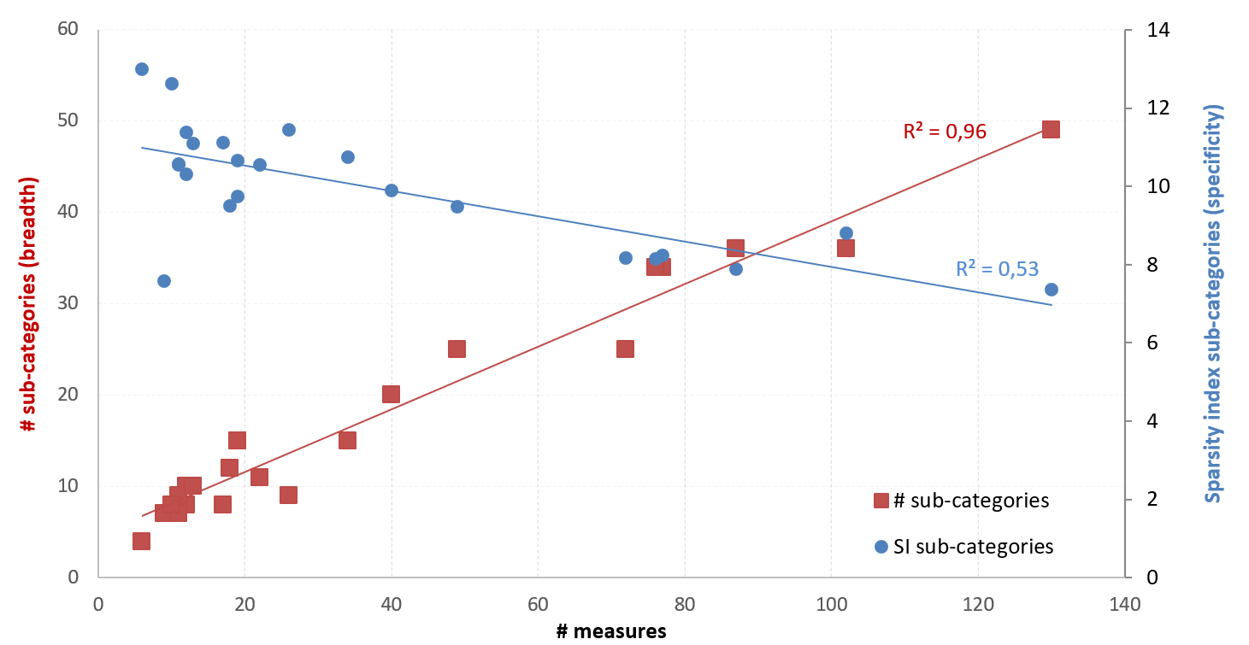
Results: Communalities vs. Specificities
+ measures
+ sub-categories
+ breadth
+ measures
+ sparsity
+ specificity
countries with a:
limited number of measures focused on common sub-categories
consistent number of measures include their own specificities

Slide 12
Results: Frequency of measures’ adoption
 | # Sub-cat | Sparsity Index Sub-cat | # Measures | SI Measures |  |  | # Sub-cat | SI Sub-cat | # Measures | SI Measures
GBR | 49 | 7,4 | 130 | 4,2 |  | BEL | 15 | 10,7 | 19 | 5,2
FIN | 36 | 8,8 | 102 | 4,5 |  | NOR | 15 | 9,7 | 19 | 4,6
IRL | 36 | 7,9 | 87 | 4,1 |  | HRV | 12 | 9,5 | 18 | 4,2
EST | 34 | 8,2 | 77 | 4,5 |  | ESP | 8 | 11,1 | 17 | 2,4
AUT | 34 | 8,1 | 76 | 4,7 |  | PRT | 10 | 11,1 | 13 | 3,5
DNK | 25 | 8,2 | 72 | 1,4 |  | NLD | 10 | 10,3 | 12 | 5,0
DEU | 25 | 9,5 | 49 | 4,0 |  | SLO | 8 | 11,4 | 12 | 3,7
LVA | 20 | 9,9 | 40 | 3,4 |  | HUN | 9 | 10,6 | 11 | 3,4
LTU | 15 | 10,7 | 34 | 4,9 |  | SWE | 7 | 10,6 | 11 | 2,7
ITA | 9 | 11,4 | 26 | 4,2 |  | CYP | 8 | 12,6 | 10 | 6,8
BGR | 11 | 10,5 | 22 | 5,4 |  | CZE | 7 | 7,6 | 9 | 2,6
 |  |  |  |  |  | ISL | 4 | 13,0 | 6 | 5,2
high sparsity of collected measures
Notes:
Varietà nella specificità …
To determine the level of diffusion of the measures adopted by each country …
most of the measures are used by a limited number of countries, while only a restricted number of measures are adopted by a relatively higher number or countries
Note that the sparsity index is not necessarily correlated either with the number of measures or with the number of country’s singularly-adopted measures, confirming a heterogeneous vision in the evaluation of child care.
The sparsity index varies between 1.4 computed over the 72 measures adopted by Denmark to 6.8 of the 10 measures reported by Cyprus. The analysis of these two extremes sheds light on two different trends in the evaluation of child care. On the one hand, Denmark provides an example of the use of a consistent number of measures focused on specific aspects that are not considered by other countries. In particular, 62 measures (86%) are exclusively used by this country and the other 8 (11%) are shared with at most other four countries. The remaining two measures are reported by another six and seven countries respectively. This is illustrated by some examples of Denmark specificity. It is the only country that reported measures related to the ADHD (Attention Deficit Hyperactivity Disorder) (8 measures) as well as those evaluating the drug consumption of children with asthma (with the exception of Spain with one measure). Moreover, Denmark is the only MOCHA country that includes in the quality assessment depression diseases analysing the consumption of antidepressants among children and adolescents even if only with one measure. On the other hand, Cyprus has no country specific measures among the limited number of those adopted. Six of the ten measures are shared with at least other five countries and only 20% (N = 2) are shared with only other two countries.
Moreover, specificities shown by a high percentage of singular measures are found in Spain (59%; N = 10), Czech R. (56%; N = 5), Hungary (55%; N = 6), Sweden (55%; N = 6) and Latvia (40%; N = 16).
high sparsity of collected measures confirming that MOCHA countries generally tend to assess the quality of child health care adopting specific measures developed according to policies, procedures and specificities of the national health system.
It is important to note that the tendency of using measures adopted by few countries is widely diffused both for countries that assess the quality using a limited number of measures and those that extend the evaluation with a high number of measures. An example of this variability is shown when considering the immunization context (14 measures in total) where there is a convergence in the use of 4 common measures (rate in general, MMR, DP3 and Hexavalent), with a country-specificity considering measures related to the different types of vaccines administered to the child at different ages according to the procedures in place in each country.
This makes it difficult to compare the achievement across countries. On the other hand, considering for example the visit in the primary care setting among the 14 measures adopted to describe child well-being visit, 10 are country specific distributed among five countries. This is also true for measures related to the secondary care setting where among the 21 measures, 17 are reported by one country (i.e. Denmark).

Slide 13
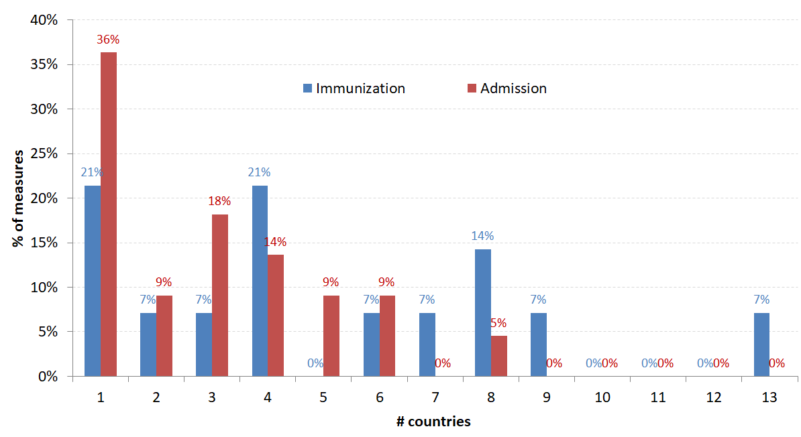
Results: Communalities vs. Specialities
Domain | Category | Sub-Category | # Countries | # Measures
Process | Prevention | Immunization | 20 | 14
Process | Specialist/hosp. care | Admission | 18 | 22
Outcome | Health Status | Mortality | 16 | 22
Process | Prevention | Well-child visit | 15 | 26
Outcome | Health Status | Morbidity | 14 | 26
Process | Specialist/hosp. care | Treatment | 12 | 11
Outcome | Health Status | Breastfeeding | 11 | 4
Structure | Child Care Provider/Wf | General | 11 | 4
Outcome | Health Status | Health issue | 11 | 4
SPEEC | Demographic | Live birth | 11 | 2
Outcome | Health Status | Birth delivery | 10 | 10
Process | Primary care mngmnt | Drug consumption | 10 | 8
Notes:
Life birth: 1) Birth rate; 2) Number of live births

Slide 14
Results: Coverage of child age range
122 measures (35%) are age-related
< 1 | [1-4] |  | [5-9] | [10-17] | > 17
29 (24%) | 2 (2%) |  | 0 | 2 (2%) | 1 (1%)
4 (3%)
6 (5%)
51 (42%)
7 (6%)
 |  |  |  | 4 (3%)
 |  | 7 (6%)
 |  |  | 8 (6%)
 |  |  | 1 (1%)
the most frequently considered single age range is the neonatal period
while the majority of measures tend to combine more than one interval
Notes:
Among the 352 measures reported by the CAs, 122 (35%) are age-related. The most frequently considered single age range is the neonatal period (29 measures), while the majority of measures (88, 72%) tend to combine more than one interval, shown in Table 7.5. This is evident by the high number of measures (N = 51; 42%) that cover the 017 year period of life and seven measures (6%) that cover the whole spectrum of age ranges. Focusing on 29 measures related to the neonatal period, particular emphasis is posed on birth and delivery (nine measures) and mortality (eight measures) and to a minor extent on breastfeeding (two measures) and health issues such as low weight newborns (one measure) and malfunctions (one measure). It is worth noting that within these measures, despite only being sparsely adopted by the MOCHA countries, there are some attempts to evaluate the preventive functions of paediatric primary care measuring the number of neonatal children being screened during well-child visits (one measure adopted by Ireland and the other by Austria, Finland, Greece, Ireland and Portugal). Focusing on the consistent number of measures covering the entire range of age groups, the majority of them (37 measures out of 58) consider childhood and adolescence as a whole period, without making any age group distinction. These measures are generally related to hospitalisation rates due to pathologies or track the prevalence/proportion of certain diseases. Moreover, the large majority of these measures are heterogeneously and sparsely distributed among the 23 countries, with the highest peak of eight countries using the same type of measure.

Slide 15
Discussion and Conclusions
High variability across countries both in the number and type of measures adopted for the evaluation of child health care
A limited set of common measures was identified, while the majority of them are reported by a restricted number of countries
The sparsity index highlights a different vision in the evaluation of child care with the selection of country-specific measures
This makes the comparison across countries a challenging task, also considering that some measures are not uniformly defined and collected across countries
Notes:
High variability across countries both in the number and type of measures adopted for the evaluation of child health care.
Within this high variability, a limited set of common measures was identified, while the majority of them are reported by 1 or 2 countries.
This is also confirmed looking at the whole range of measures used at country level on the basis of the sparsity index that highlights a different vision in the evaluation of child care with the selection of specific measures whose use is generally restricted to one country.
This makes the comparison across countries a challenging task. This applies also for some common measures that have different variables such as diverse child’s age ranges and/or that are not uniformly defined and collected across countries.
Even if the distribution of measures within the five identified domains indicates the tendency of privileging the adoption of measures related to process and outcome, variations among countries are remarkable showing a prevalence in the selection of measures in a specific domain.
Only a limited number of countries adopt measures related to the non-medical determinants of health which are proved to be essential in the evaluation of child care. Remarkably, only six countries cover all the domains.
Considering the sub-categories of the conceptual map a set of common aspects can be detected (immunization, mortality and hospitalization). However, other important aspects of child health care are subject to national preferences, such as primary care, well-child visits, and addiction. In particular, nutritional priority and addiction that are considered important quality indicators by the strategy developed by the WHO regional office for the period 2015-2020 [6].
This sparse adoption of measures also influences the breadth of the analysis that is more evident in a few countries that adopt a higher number of measures, showing that more efforts are needed in the majority of the countries of the EU and EEA in the collection of a wider spectrum of child centric data and related metrics.
Although these measures are specifically targeted for children, they are limited in the breadth of aspects to be considered to evaluate the child psychophysical development, such as measures related to primary and secondary care visits which can extend the evaluation of child-specific preventive and curative care. They prioritized the first years of life leaving out other important phases of child development.

Slide 16
Discussion and Conclusions
A set of common sub-categories can be detected, such as immunization, mortality and hospitalization
However, additional aspects of child health care are included in some countries, with particular attention on child life course as well as nutritional priority and addiction
This sparse adoption of measures also influences the breadth of the analysis, showing that more efforts are needed in the majority of the countries in the collection of child centric data and related metrics
Notes:
Considering the sub-categories of the conceptual map a set of common aspects can be detected (immunization, mortality and hospitalization). However, other important aspects of child health care are subject to national preferences, such as primary care, well-child visits, and addiction. In particular, nutritional priority and addiction that are considered important quality indicators by the strategy developed by the WHO regional office for the period 2015-2020 [6].
This makes the comparison across countries a challenging task. This applies also for some common measures that have different variables such as diverse child’s age ranges and/or that are not uniformly defined and collected across countries.
This sparse adoption of measures also influences the breadth of the analysis that is more evident in a few countries that adopt a higher number of measures, showing that more efforts are needed in the majority of the countries of the EU and EEA in the collection of a wider spectrum of child centric data and related metrics.
Although these measures are specifically targeted for children, they are limited in the breadth of aspects to be considered to evaluate the child psychophysical development, such as measures related to primary and secondary care visits which can extend the evaluation of child-specific preventive and curative care. They prioritized the first years of life leaving out other important phases of child development.

Slide 17
Discussion and Conclusions
Although these measures are specifically targeted for children, they are limited in the breadth of aspects to be considered to evaluate the child psychophysical development, such as primary and secondary care visits which can extend the evaluation of child-specific preventive and curative care
Measures prioritized the first years of life leaving out other important phases of child development, such as adolescence
Notes:
High variability across countries both in the number and type of measures adopted for the evaluation of child health care.
Within this high variability, a limited set of common measures was identified, while the majority of them are reported by 1 or 2 countries.
This is also confirmed looking at the whole range of measures used at country level on the basis of the sparsity index that highlights a different vision in the evaluation of child care with the selection of specific measures whose use is generally restricted to one country.
Even if the distribution of measures within the five identified domains indicates the tendency of privileging the adoption of measures related to process and outcome, variations among countries are remarkable showing a prevalence in the selection of measures in a specific domain.
Only a limited number of countries adopt measures related to the non-medical determinants of health which are proved to be essential in the evaluation of child care. Remarkably, only six countries cover all the domains.
Considering the sub-categories of the conceptual map a set of common aspects can be detected (immunization, mortality and hospitalization). However, other important aspects of child health care are subject to national preferences, such as primary care, well-child visits, and addiction. In particular, nutritional priority and addiction that are considered important quality indicators by the strategy developed by the WHO regional office for the period 2015-2020 [6].
This makes the comparison across countries a challenging task. This applies also for some common measures that have different variables such as diverse child’s age ranges and/or that are not uniformly defined and collected across countries.
This sparse adoption of measures also influences the breadth of the analysis that is more evident in a few countries that adopt a higher number of measures, showing that more efforts are needed in the majority of the countries of the EU and EEA in the collection of a wider spectrum of child centric data and related metrics.
Although these measures are specifically targeted for children, they are limited in the breadth of aspects to be considered to evaluate the child psychophysical development, such as measures related to primary and secondary care visits which can extend the evaluation of child-specific preventive and curative care. They prioritized the first years of life leaving out other important phases of child development.

Slide 18
Thank you for the attention
f.pecoraro@irpps.cnr.it

Slide 19
Disclosure Statement
Speakers Name
…… Fabrizio Pecoraro ……
 I have the following potential conflicts of interest
to report:
 Research Contracts
 Consulting
 Employment in the Industry
 Stockholder of a healthcare company
 Owner of a healthcare company
 Other(s) – please include details
No commercial logos or product names to be included please.
X I declare that I have no potential conflict of interest.

Slide 20
Results: Frequency of measures’ adoption
Country | # of measures | Sparsity index | # (%) of measures reported only by the country | Country | # of measures | Sparsity index | # (%) of measures reported only by the country
UK | 130 | 4.2 | 1 (1) | BEL | 19 | 5.2 | 4 (21)
FIN | 102 | 4.5 | 4 (4) | NOR | 19 | 4.6 | 1 (5)
IRL | 87 | 4.1 | 14 (16) | HRV | 18 | 4.2 | 2 (11)
EST | 77 | 4.5 | 5 (6) | ESP | 17 | 2.4 | 10 (59)
AUT | 76 | 4.7 | 1 (1) | PRT | 13 | 3.5 | 3 (23)
DNK | 72 | 1.4 | 62 (86) | NLD | 12 | 5.0 | 1 (8)
DEU | 49 | 4.0 | 7 (14) | SLO | 12 | 3.7 | 1 (8)
LVA | 40 | 3.4 | 16 (40) | HUN | 11 | 3.4 | 6 (55)
LTU | 34 | 4.9 | 3 (9) | SWE | 11 | 2.7 | 6 (55)
ITA | 26 | 4.2 | 4 (15) | CYP | 10 | 6.8 | 0 (0)
BGR | 22 | 5.4 | 0 (0) | CZE | 9 | 2.6 | 5 (56)
 |  |  |  | ISL | 6 | 5.2 | 1 (17)
high sparsity of collected measures
Notes:
Varietà nella specificità …
To determine the level of diffusion of the measures adopted by each country …
most of the measures are used by a limited number of countries, while only a restricted number of measures are adopted by a relatively higher number or countries
Note that the sparsity index is not necessarily correlated either with the number of measures or with the number of country’s singularly-adopted measures, confirming a heterogeneous vision in the evaluation of child care.
The sparsity index varies between 1.4 computed over the 72 measures adopted by Denmark to 6.8 of the 10 measures reported by Cyprus. The analysis of these two extremes sheds light on two different trends in the evaluation of child care. On the one hand, Denmark provides an example of the use of a consistent number of measures focused on specific aspects that are not considered by other countries. In particular, 62 measures (86%) are exclusively used by this country and the other 8 (11%) are shared with at most other four countries. The remaining two measures are reported by another six and seven countries respectively. This is illustrated by some examples of Denmark specificity. It is the only country that reported measures related to the ADHD (Attention Deficit Hyperactivity Disorder) (8 measures) as well as those evaluating the drug consumption of children with asthma (with the exception of Spain with one measure). Moreover, Denmark is the only MOCHA country that includes in the quality assessment depression diseases analysing the consumption of antidepressants among children and adolescents even if only with one measure. On the other hand, Cyprus has no country specific measures among the limited number of those adopted. Six of the ten measures are shared with at least other five countries and only 20% (N = 2) are shared with only other two countries.
Moreover, specificities shown by a high percentage of singular measures are found in Spain (59%; N = 10), Czech R. (56%; N = 5), Hungary (55%; N = 6), Sweden (55%; N = 6) and Latvia (40%; N = 16).
high sparsity of collected measures confirming that MOCHA countries generally tend to assess the quality of child health care adopting specific measures developed according to policies, procedures and specificities of the national health system.
It is important to note that the tendency of using measures adopted by few countries is widely diffused both for countries that assess the quality using a limited number of measures and those that extend the evaluation with a high number of measures. An example of this variability is shown when considering the immunization context (14 measures in total) where there is a convergence in the use of 4 common measures (rate in general, MMR, DP3 and Hexavalent), with a country-specificity considering measures related to the different types of vaccines administered to the child at different ages according to the procedures in place in each country.
This makes it difficult to compare the achievement across countries. On the other hand, considering for example the visit in the primary care setting among the 14 measures adopted to describe child well-being visit, 10 are country specific distributed among five countries. This is also true for measures related to the secondary care setting where among the 21 measures, 17 are reported by one country (i.e. Denmark).

Slide 21
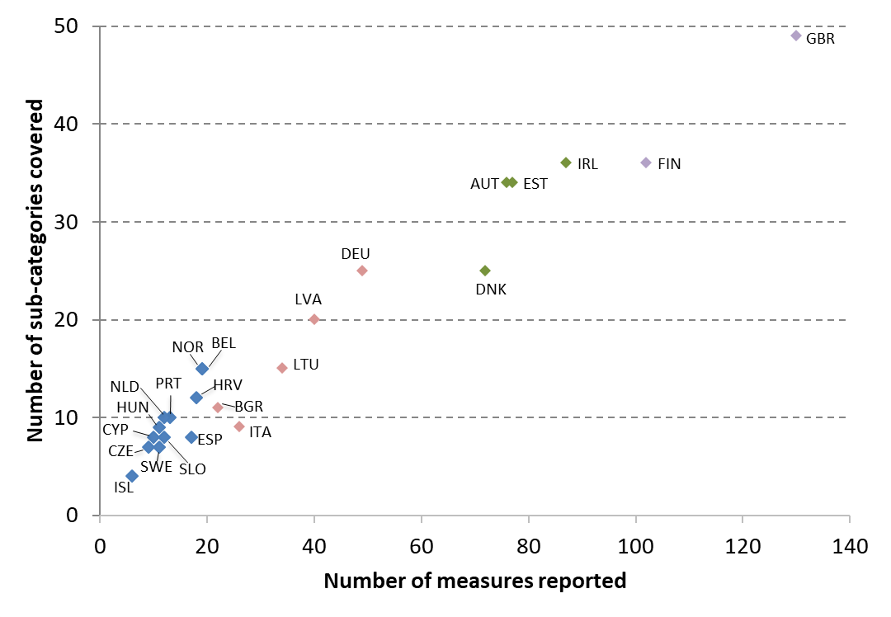
Results: Frequency of measures’ adoption
countries with a higher number of measures
cover different and extensive aspects
Notes:
As shown in Figure 4, there is a high-variability among countries not only considering the number of measures reported as highlighted in the previous analysis, but also on the number of sub-categories covered that can be an indication of the breath of factors considered in the assessment of the quality of child care. This analysis can contribute to outline the level of multidimensionality adopted in each MOCHA country, providing a snapshot on the different degrees of efforts in place to assess the quality of care. In particular, countries with a higher number of measures tend to explore the quality of care covering different and extensive aspects.

Slide 22
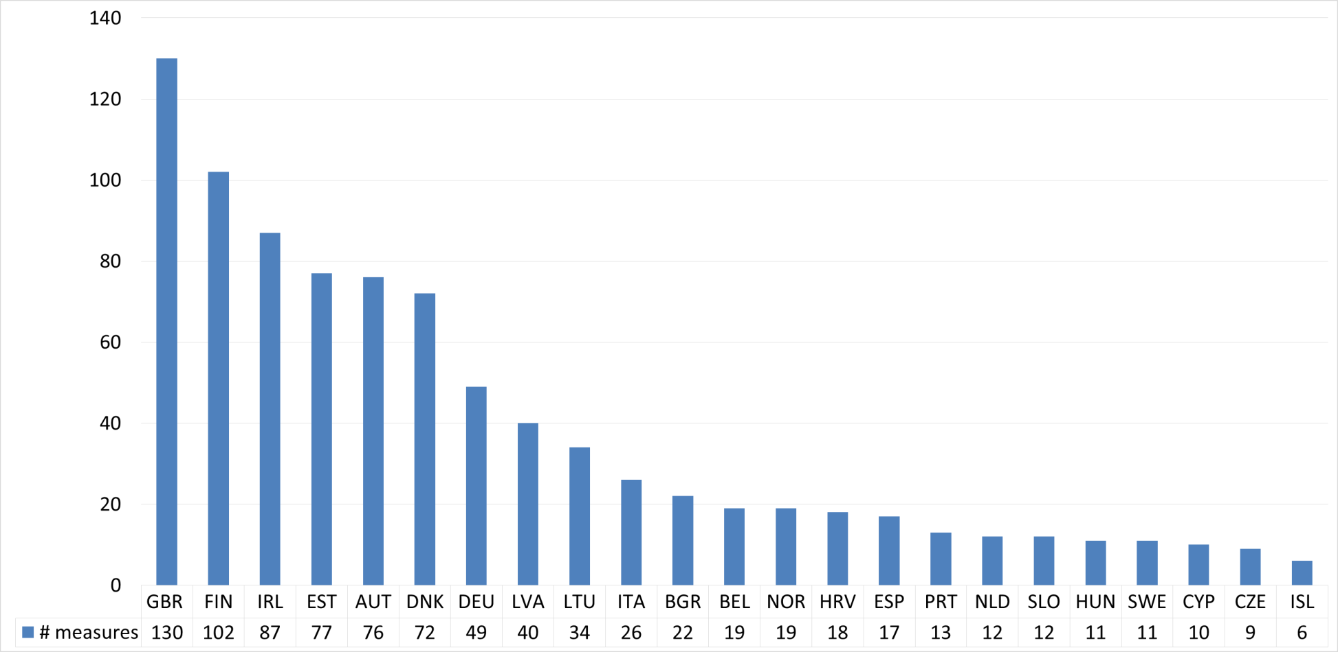
Results: Quantity and distribution of measures
the amount of collected measures is not equally distributed among countries
Notes:
The amount of collected measures is not equally distributed among countries, as they range from a minimum of 6 measures in Iceland to a maximum of 130 in the UK. In particular, as shown in Figure 2, more than half of the countries (N = 12) use less than 20 measures to assess the quality of child health care, while only 6 countries use at least 50 measures, thus highlighting a heterogeneous adoption of measures across countries.

Slide 23
Methodology: Analysis
Analyze the quantity and distribution of measures across countries
Explore whether a country adopts a similar set of measures or extends the evaluation with measures that are not shared among countries
Analyse the breath of evaluation of child care at country level
Investigate the coverage of child age ranges to capture the level of child invisibility
Notes:
1) NON SO …
2) to detect the communalities across countries and the specificities adopted at country level
3) Breadth
4) Age
+ Moreover, to identify whether a core set of common measures is adopted across countries, we analysed measures reported by at least 25% of the CAs under the perspective of child-centeredness which may be also expressed by age ranges reported as variable of the measures and disease specificity.
The UN Convention on the Rights of the Child [5] defines a “child” a person below the age of 18; in our study to evaluate the age-specific measures, age classes compatible with the life course were created as follows: <1, 1-4, 5-9, 10-17, and 18-24 years. This allowed the identification of an important and frequently analysed life period, such as maternal and perinatal health, and the challenging upper end of childhood which is so often lost in statistical analyses [23].

Slide 24
Results: Frequency of measures’ adoption
 | # sub-cat | SI sub-cat | # meas | SI meas | # meas rep only by the country |  |  | # sub-cat | SI sub-cat | # meas | SI meas | # meas rep only by the country
GBR | 49 | 7,4 | 130 | 4,2 | 1 (1) |  | BEL | 15 | 10,7 | 19 | 5,2 | 4 (21)
FIN | 36 | 8,8 | 102 | 4,5 | 4 (4) |  | NOR | 15 | 9,7 | 19 | 4,6 | 1 (5)
IRL | 36 | 7,9 | 87 | 4,1 | 14 (16) |  | HRV | 12 | 9,5 | 18 | 4,2 | 2 (11)
EST | 34 | 8,2 | 77 | 4,5 | 5 (6) |  | ESP | 8 | 11,1 | 17 | 2,4 | 10 (59)
AUT | 34 | 8,1 | 76 | 4,7 | 1 (1) |  | PRT | 10 | 11,1 | 13 | 3,5 | 3 (23)
DNK | 25 | 8,2 | 72 | 1,4 | 62 (86) |  | NLD | 10 | 10,3 | 12 | 5,0 | 1 (8)
DEU | 25 | 9,5 | 49 | 4,0 | 7 (14) |  | SLO | 8 | 11,4 | 12 | 3,7 | 1 (8)
LVA | 20 | 9,9 | 40 | 3,4 | 16 (40) |  | HUN | 9 | 10,6 | 11 | 3,4 | 6 (55)
LTU | 15 | 10,7 | 34 | 4,9 | 3 (9) |  | SWE | 7 | 10,6 | 11 | 2,7 | 6 (55)
ITA | 9 | 11,4 | 26 | 4,2 | 4 (15) |  | CYP | 8 | 12,6 | 10 | 6,8 | 0 (0)
BGR | 11 | 10,5 | 22 | 5,4 | 0 (0) |  | CZE | 7 | 7,6 | 9 | 2,6 | 5 (56)
 |  |  |  |  |  |  | ISL | 4 | 13,0 | 6 | 5,2 | 1 (17)
high sparsity of collected measures
Notes:
Varietà nella specificità …
To determine the level of diffusion of the measures adopted by each country …
most of the measures are used by a limited number of countries, while only a restricted number of measures are adopted by a relatively higher number or countries
Note that the sparsity index is not necessarily correlated either with the number of measures or with the number of country’s singularly-adopted measures, confirming a heterogeneous vision in the evaluation of child care.
The sparsity index varies between 1.4 computed over the 72 measures adopted by Denmark to 6.8 of the 10 measures reported by Cyprus. The analysis of these two extremes sheds light on two different trends in the evaluation of child care. On the one hand, Denmark provides an example of the use of a consistent number of measures focused on specific aspects that are not considered by other countries. In particular, 62 measures (86%) are exclusively used by this country and the other 8 (11%) are shared with at most other four countries. The remaining two measures are reported by another six and seven countries respectively. This is illustrated by some examples of Denmark specificity. It is the only country that reported measures related to the ADHD (Attention Deficit Hyperactivity Disorder) (8 measures) as well as those evaluating the drug consumption of children with asthma (with the exception of Spain with one measure). Moreover, Denmark is the only MOCHA country that includes in the quality assessment depression diseases analysing the consumption of antidepressants among children and adolescents even if only with one measure. On the other hand, Cyprus has no country specific measures among the limited number of those adopted. Six of the ten measures are shared with at least other five countries and only 20% (N = 2) are shared with only other two countries.
Moreover, specificities shown by a high percentage of singular measures are found in Spain (59%; N = 10), Czech R. (56%; N = 5), Hungary (55%; N = 6), Sweden (55%; N = 6) and Latvia (40%; N = 16).
high sparsity of collected measures confirming that MOCHA countries generally tend to assess the quality of child health care adopting specific measures developed according to policies, procedures and specificities of the national health system.
It is important to note that the tendency of using measures adopted by few countries is widely diffused both for countries that assess the quality using a limited number of measures and those that extend the evaluation with a high number of measures. An example of this variability is shown when considering the immunization context (14 measures in total) where there is a convergence in the use of 4 common measures (rate in general, MMR, DP3 and Hexavalent), with a country-specificity considering measures related to the different types of vaccines administered to the child at different ages according to the procedures in place in each country.
This makes it difficult to compare the achievement across countries. On the other hand, considering for example the visit in the primary care setting among the 14 measures adopted to describe child well-being visit, 10 are country specific distributed among five countries. This is also true for measures related to the secondary care setting where among the 21 measures, 17 are reported by one country (i.e. Denmark).

