Slide 1
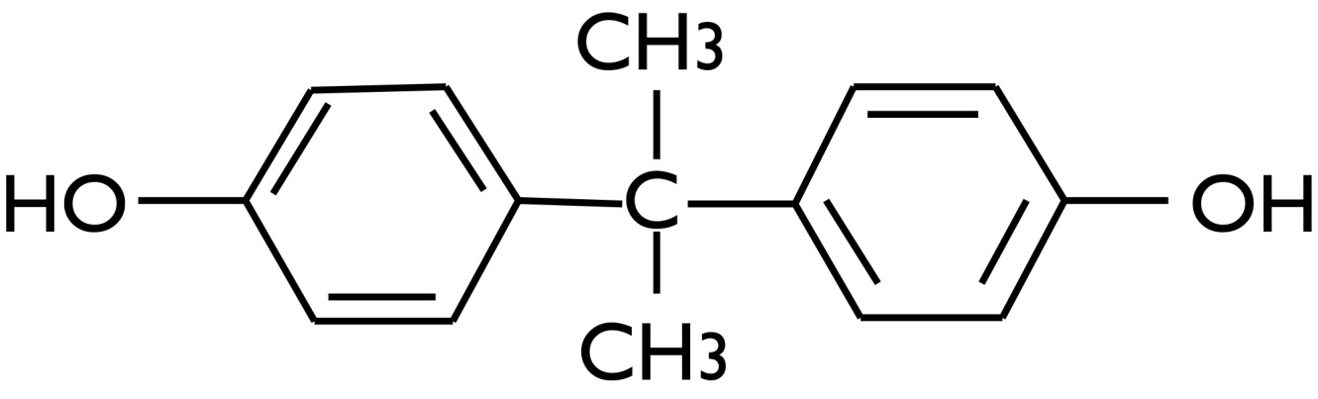

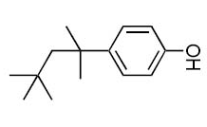
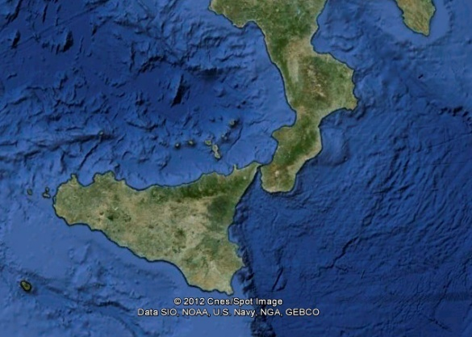
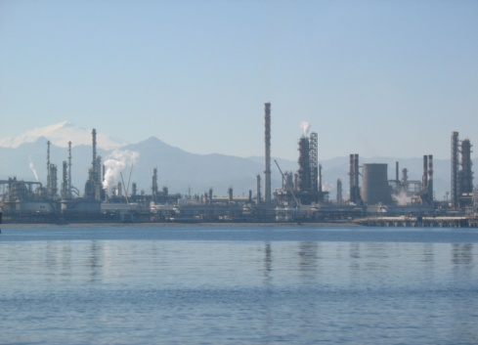
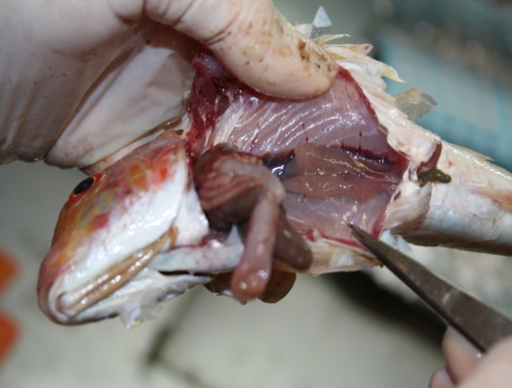


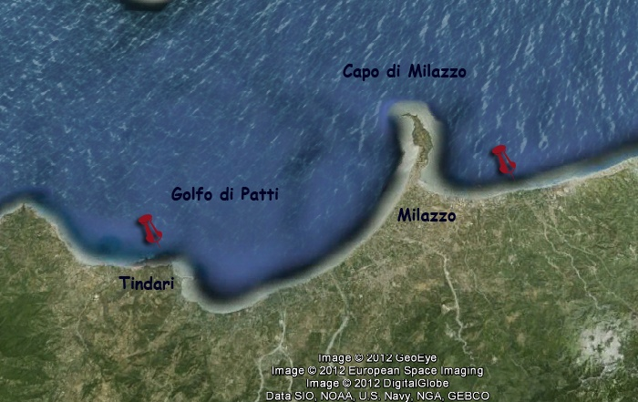

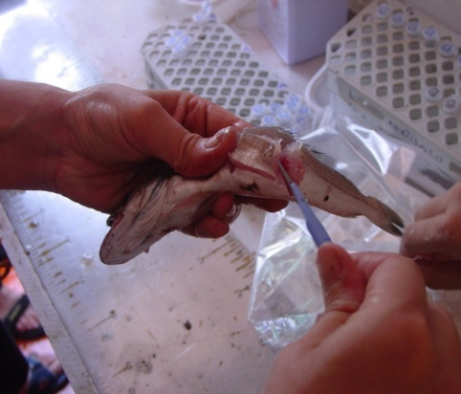
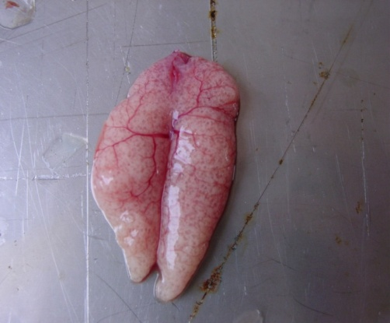

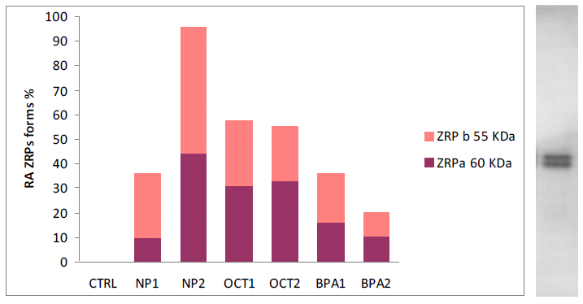
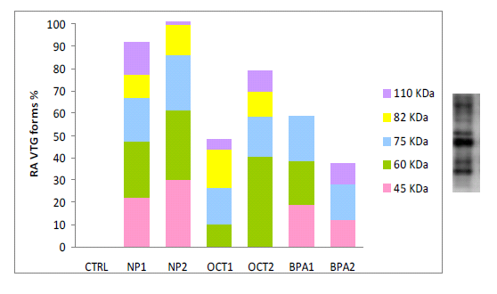
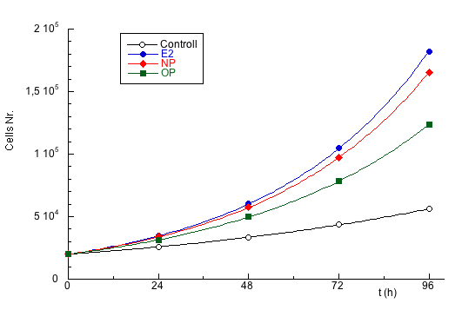
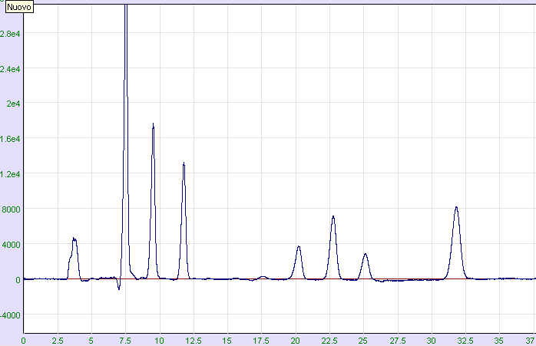
FOOD AND ENVIRONMENTAL SAFETY: AN INTEGRATED APPROACH TO THE STUDY OF THE CONCENTRATIONS AND EFFECTS BISPHENOL A, NONYLPHENOL AND OCTYLPHENOL IN FISH
Damiano G. Mita¹, Stefania Albrizio², Oliana Carnevali³, Nadia Diano¹, Pasquale Gallo^{4,}*, Lucia Grumetto², Alberta Mandich⁵, Valeria Micale⁶. ¹Interuniversity Consortium National Institute of Biosystems and Biostructures, Italy. ²University of Naples, Naples, Italy. ³Università Politecnica delle Marche, Ancona, Italy. ⁴Istituto Zooprofilattico Sperimentale del Mezzogiorno, Portici, Italy. ⁵University of Genova, Genova, Italy, ⁶Istituto per l’Ambiente Marino Costiero, Consiglio Nazionale delle Ricerche, Messina, Italy.
XVII ICCE, Barcelona, Spain 15-19 July 2013
pasquale.gallo@cert.izsmportici.it funded by the Italian Ministry of Health project RF-2009-1536185
INTRODUCTION
Strict relationships between environmental pollution and food contamination have been widely described in several outbreaks all over the world. In this work, we describe a research project funded by the Italian Ministry of Health, in the framework of food safety assessment and evaluation, for consumer protection, regarding some Endocrine Disruptor Chemicals (EDCs). Bisphenol A (BPA), nonylphenol (NP), octylphenol (OP) and some heavy metals were chosen as the main topics of our study.
The approach to this research project is multi-disciplinary. The professional competence of the partners will be complementary. This will ensure that the information will be complete and integrated.
The main purposes of the project are the following:
to define new biomarkers for monitoring sea pollution by EDCs
monitoring of contamination levels of some EDCs in fish and mollusk from Italian market
to develop novel bioremediation systems of waters polluted by the EDCs of interest
BISPHENOL A
(BPA)
NONYLPHENOL
(NP)
OCTYLPHENOL
(OP)
TASK 1
monitoring of the marine environment through specific biological and histological biomarkers detected in fish from high polluted areas
TASK 4
the observation of the possible endocrine effects induced by different feed in fish reared in aquaculture tanks
AREA DI STUDIO
Site 2
Site 1
Development stage
Intersexuality
Oocyte atresia
Iperplastic/ipertrofic perifollicular cells
Interstitial fibrosis
Macrophages aggregation
Granulocyte inflammation
Mineralization
Sampling site 1 (industrial area) and site 2 (protected area) in Sicily
Sample characterization
(Mullus barbatus)
Development stage
Sperm abnormality (SEM, TEM)
Intersexuality
Degeneratione of germinal epithelium
Iperplastic/ipertrofic cells of Leydig and Sertoli
Macrophages aggregation
Granulocyte inflammation
Interstitial fibrosis
Mineralization
Effects of exposure to BPA, NP and OP on target tissues from Spaurus aurata (orata)
TASK 2
an in vivo study about the effects of exposure to BPA, NP, OP on a selected fish species reared in aquaria
GILLS: Cat
LIVER: EROD
NP
OP
NP
OP
BPA
BPA
Levels of BPA, NP and OP in muscle and liver of exposed samples of Mullus barbatus (triglia) from industrial Site 1 in Sicily
TASK 3
the direct measurement of pollution through the determination of the concentration levels of the EDCs of interest in seafood, by chromatographic and hyphenated techniques
TASK 6
the development of novel bioremediation systems of waters polluted by the EDCs of interest
TASK 5
determination of EDC levels in seafood canned in metal and glass containers
MCF-7 cell proliferation in presence of some EDCs
HPLC with fluorescence detection of BPA and other 4 bisphenols in canned tuna
BPF
BPA
BPB
BADGE
Scheme of the bioreactor
BFDGE

