Slide 1
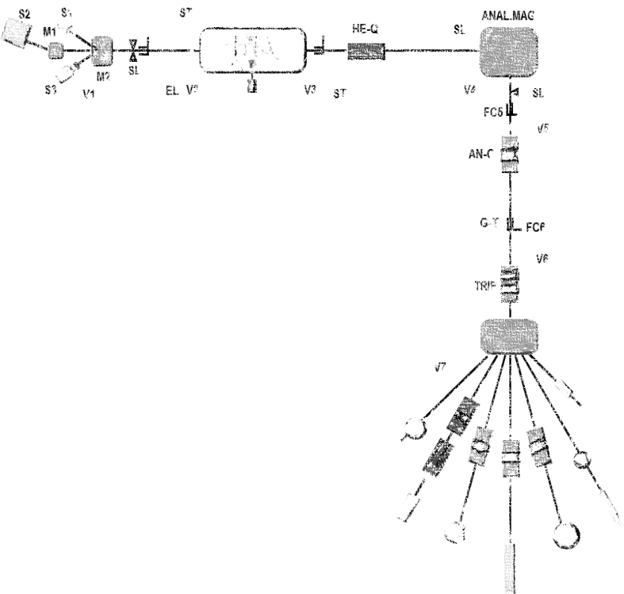
Fundamental and applied radiobiological research using low-energy accelerated particle beams
Lorenzo Manti
Radiation Biophysics Laboratory
Physics Department “E. Pancini”, University of Naples Federico II and INFN, Naples Section
Workshop on basic research and interdisciplinary applications with small accelerators
Naples, 17-18 January 2018

Slide 2
Outline
Particle radiobiology
Past research carried out at the Naples Tandem Accelerator
  Ion type- and track structure-dependence of the radiobiological effectiveness of accelerated ion beams
  Modulation by UMTS signals of the acute and long-term cellular effects from alpha particles at energies typical of radon exposure
Current & future research using low-energy accelerated particles
  Hadrontherapy-related particle fragmentation
  Towards proton-boron capture therapy

Slide 3
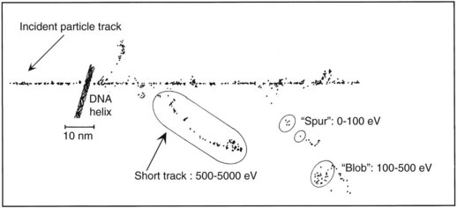
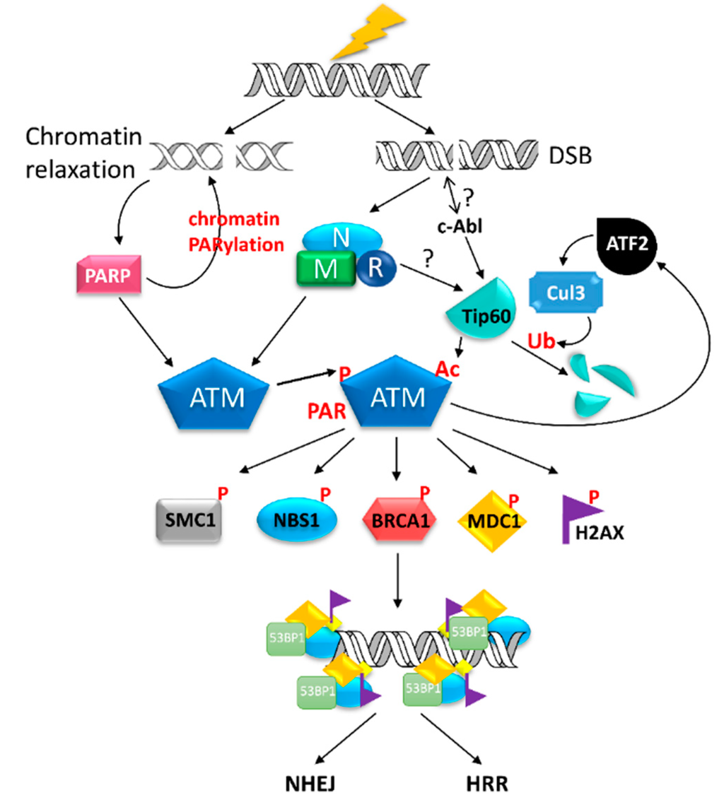
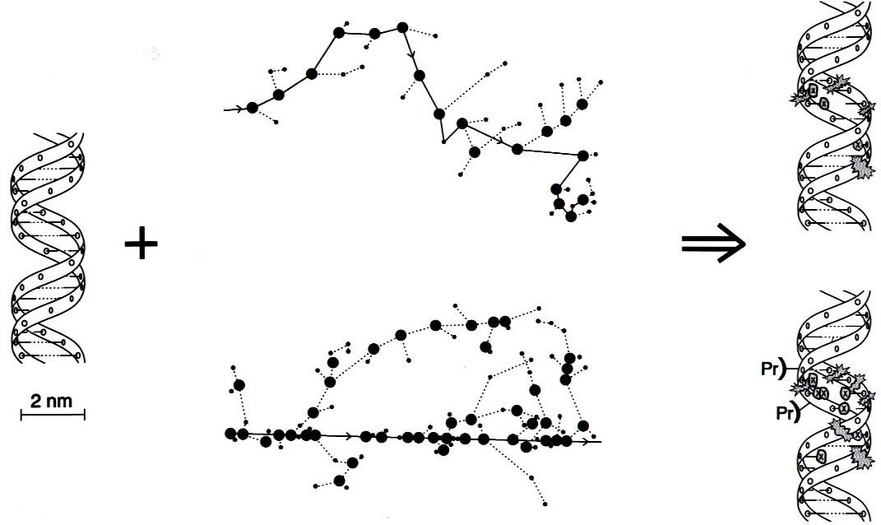
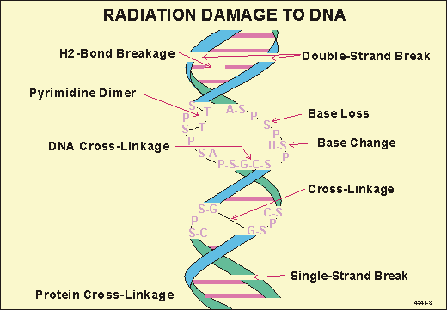
Physics governs cellular response
  Ionising radiation (IR) is unique among all the mutagen and carcinogen agents because of its peculiar interaction with matter
  Damage processing proceeds via a complex cascade of biochemical mechanisms at the molecular and cellular level
  The nature and severity of the resulting lesions mirror the energy deposition pattern at the nanoscale level
Parts of:
Electron track
Alpha-particle track
[ Goodhead, IJRB 65, 7 (1994) ]

Slide 4
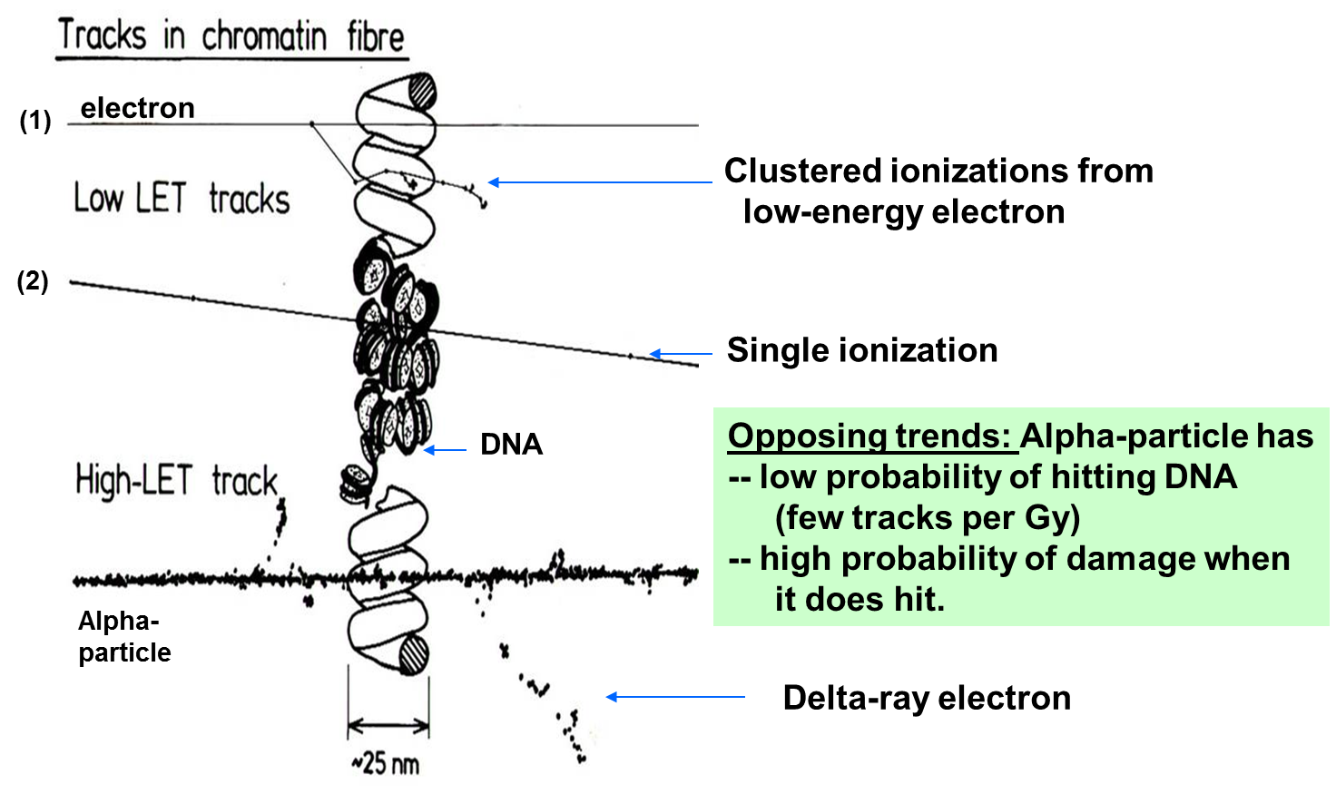
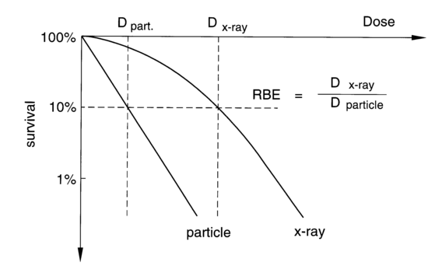
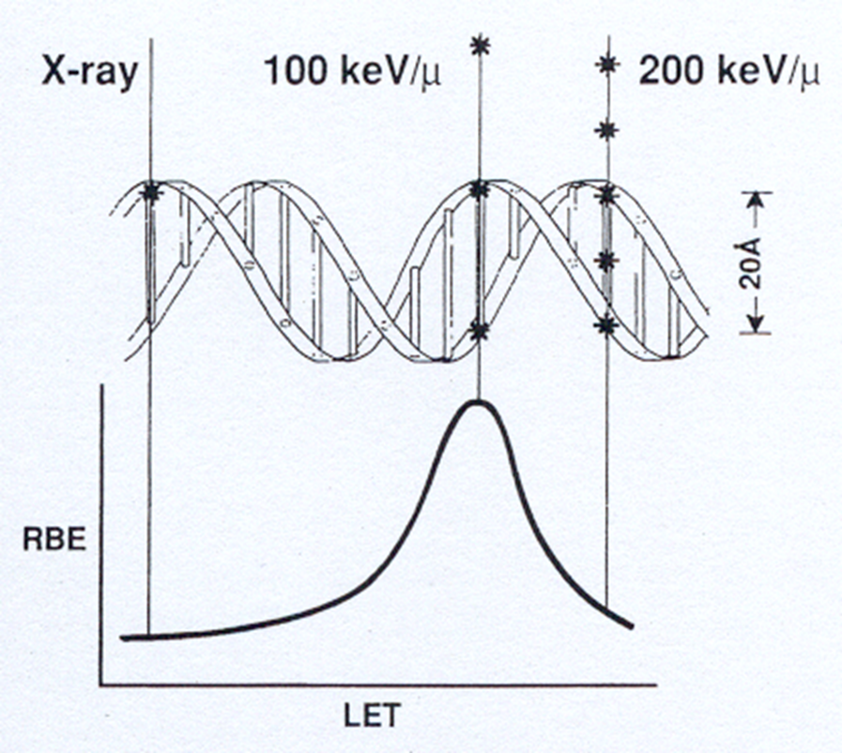
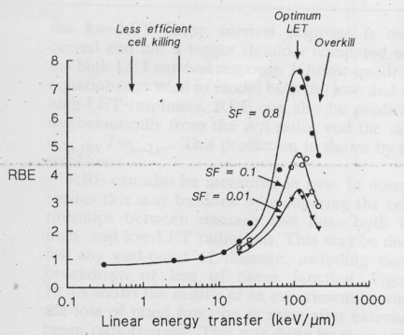
Radiation quality and biological response to IR

Slide 5
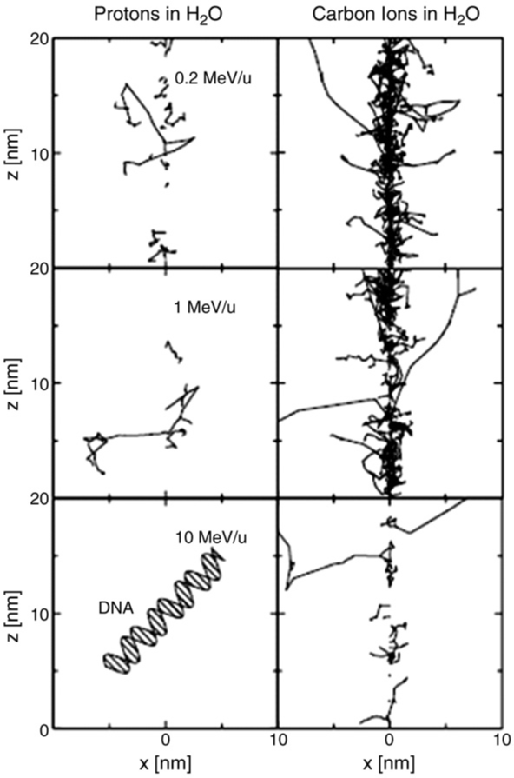
Track structure
LET alone not a predictor of cellular response to particle radiation
Role of ion track structure
  Energy deposited differently according to the ion mass and initial energy
  Track diameter not proportional to LET, depends on particle velocity and, at a given energy, on ion Z
Highly inhomogeneous damage clustering within and around the track for various ions of the same LET
  Protons and carbon ions of similar LET values have different RBEs
Notes:
However, it is acknowledged that the radiation effectiveness is critically determined by the configuration of all the ionisation events caused by primary and secondary particles, that is the ion track structure

Slide 6
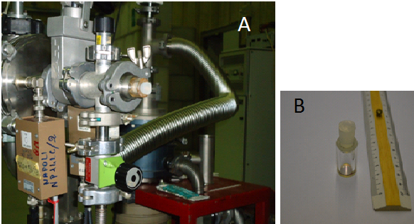
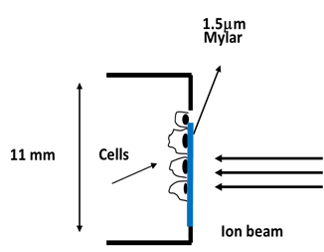
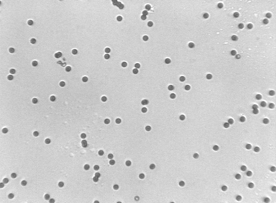
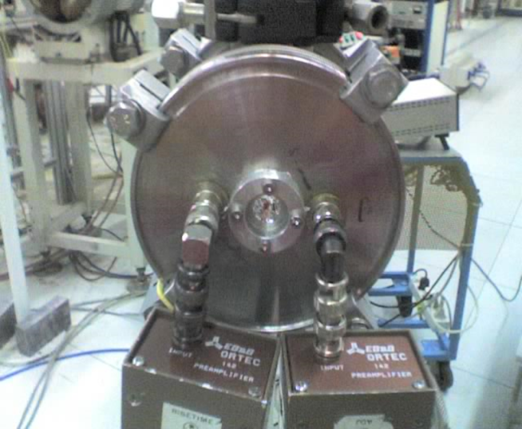
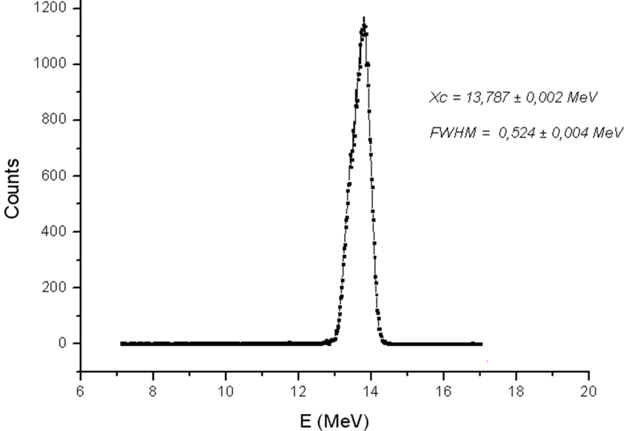
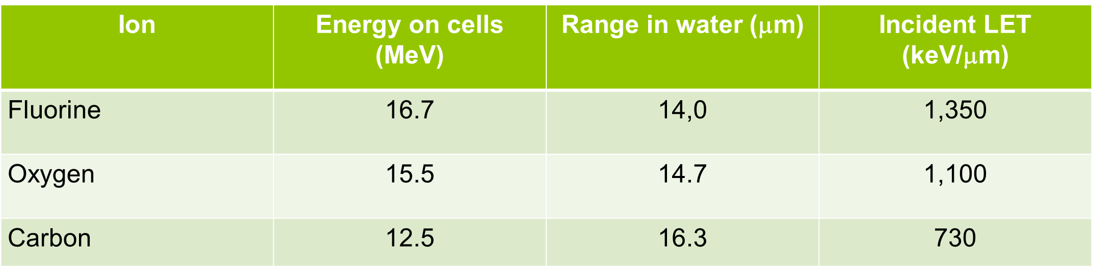
Irradiation set up at Naples Tandem

Slide 7
Survival following very-high LET ions

Slide 8
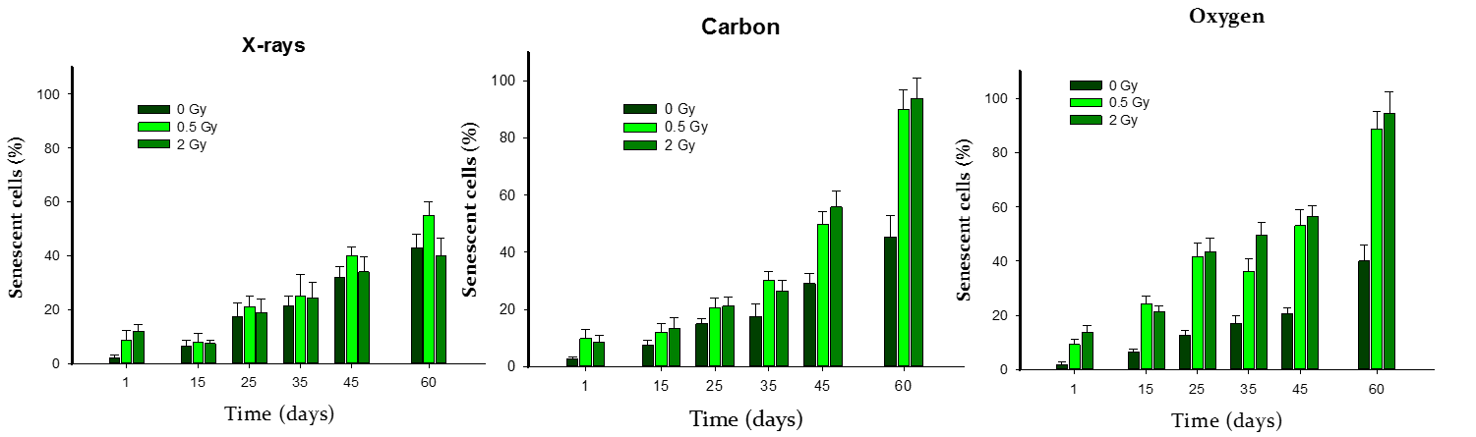
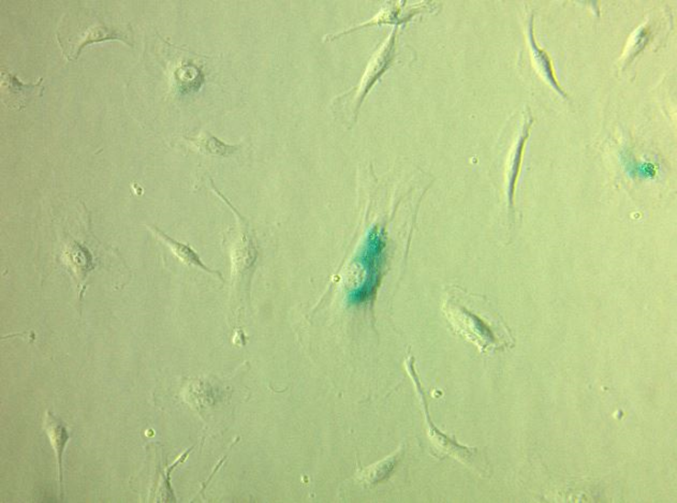
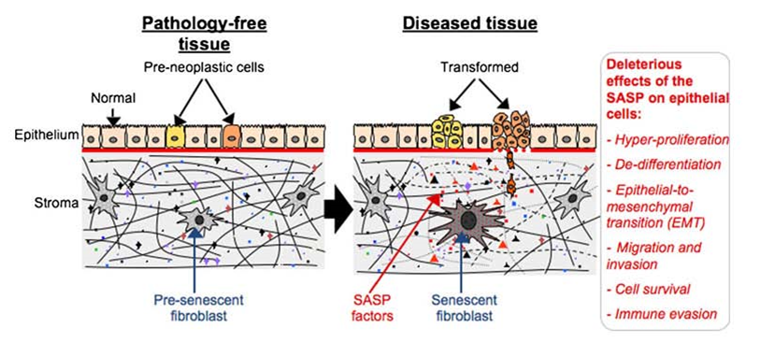
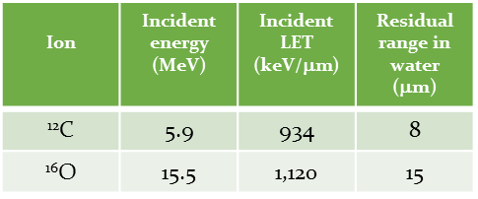
Cellular senescence following very-high LET ions

Slide 9
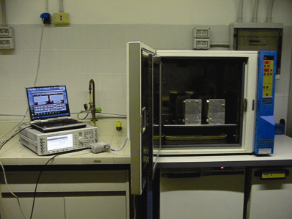
Combined exposures-1
Power control
Exposed samples
Sham
Signal generator
Waveguides
Power meter
h-TERT human bronchial cells (HBEC-3kT) were co-exposed to high -LET low-fluence α-particles in the dose range 0-0.6 Gy (incident energy 5.5 MeV, LET = 120 keV/μ), produced at the 3-MV Tandem accelerator . Cells were subsequently incubated for 24 h in a thermostated waveguide fed by an UMTS signal (1.95 GHz, SAR = 2.0 W/kg).

Slide 10
Combined exposures-2

Slide 11
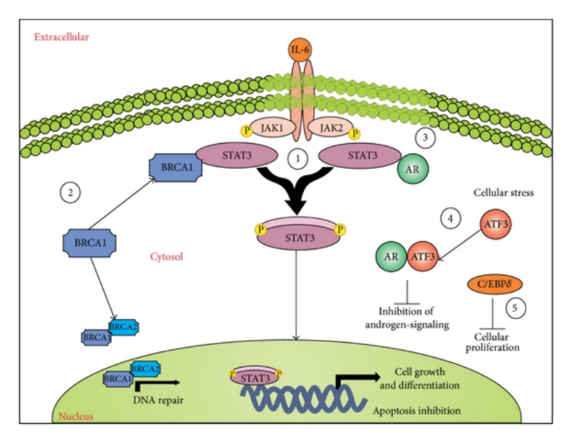
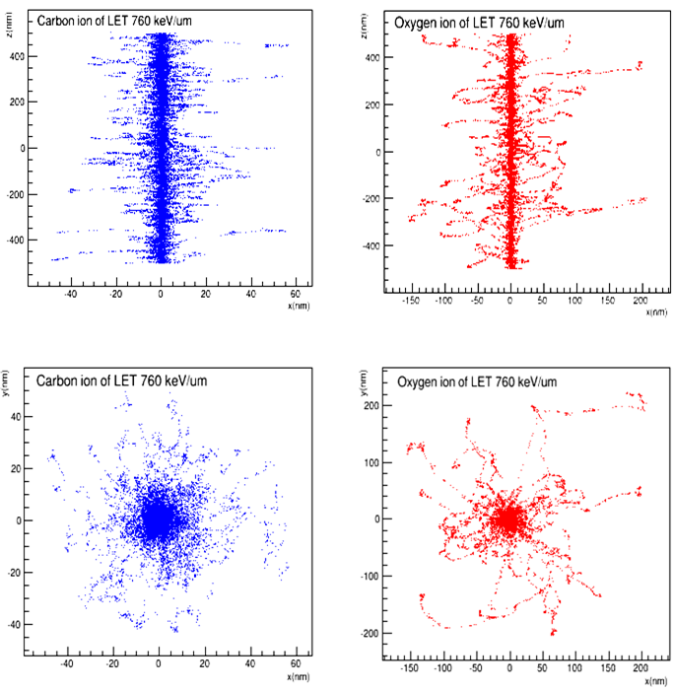
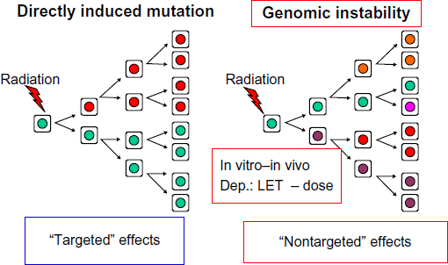
Main results
Deviation from predicted RBE-LET dependence
Exacerbation of high LET-induced genomic instability by RF signals

Slide 12
Naples Tandem output (2009-12)
Papers & proceedings:
Development of a low-energy particle irradiation facility for the study of the biological effectiveness of the ion track end. JOURNAL OF PHYSICS. CONFERENCE SERIES, Manti L. et al.,. vol. 373, p. 012019-012026, ISSN: 1742-6588, doi:10.1088/1742-6596/373/1/012019 (2012).
BioEM2009 Joint meeting of The Bioelectromagnetics Society (BEMS) and the European BioElectromagnetics Association (EBEA). Effects Of UMTS Signal (1.95 GHz) On Cytogenetic Damage Induced By Ionising Radiation Of Varying Quality Radiation In Human Cells In Vitro. Manti L. et al., Davos, Svizzera, giugno 2009.
37th annual meeting of the European Radiation Research Society (ERRS). In Vitro effects of exposure to radiofrequency on DNA damage induced by high-LET ionising radiation. Manti L. et al., Praga, Rep. Ceca, agosto 2009.
38th annual meeting of the European Radiation Research Society (ERRS). Combined exposure of human cells to high-LET radiation and UMTS signal: acute damage and genomic instability.Manti L. et al.,Campajola. Stoccolma (Svezia) settembre 2010.
XV Convegno Nazionale della Società per la Ricerche sulle Radiazioni (SIRR). Influenza del segnale UMTS (1.95 GHz) su danno citogenetico acuto ed instabilità genomica indotti in vitro da radiazione ionizzante ad alto LET. D’Arco A. et al.,Roma, ottobre 2010.
14th International Congress of Radiation Research, Irradiation of tumour cell lines with very high-LET particle beams accelerated at Naples Tandem facility. Manti L. et al., Varsavia (Polonia), agosto 2011.
ION BEAMS '12 - Multidisciplinary Applications of Nuclear Physics with Ion Beams- Influence of the ion type on the radiobiological effectiveness of accelerated ion beams. Manti L. et al., Legnaro, LNL-INFN (Padova) , giugno 2012
MSc Theses in Physics
Annalisa D'Arco, 2009-10, «Effetti combinati derivanti dall’esposizione in vitro di cellule umane alla radiazione ionizzante di vario LET ed a campi a radiofrequenza”
Francesca Margaret Perozziello, 2011-12 “Caratterizzazione radiobiofisica di fasci di ioni carbonio, ossigeno e fluoro accelerati al Tandem TTT-3 del Dipartimento di Scienze Fisiche dell’Università di Napoli Federico II”
Carla Maiorino, 2011-12 “Studio degli effetti subletali indotti da radiazioni ad alto LET e diverso Z nell’ambito del progetto MiMo-Bragg”
Giuseppe Signore, 2012-13, “ Effetti radiobiologici di ioni su cellule umane: modellizzazione mediante il toolkit GEANT4 della perdita di energia”

Slide 13
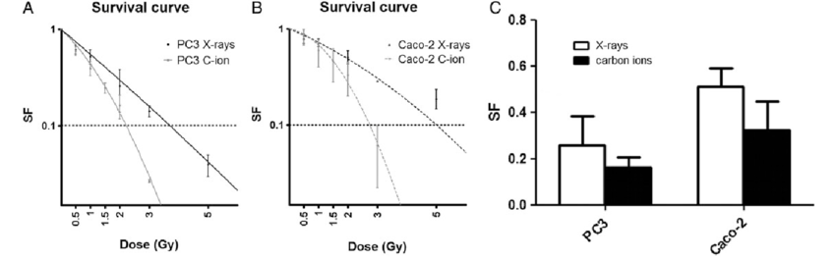
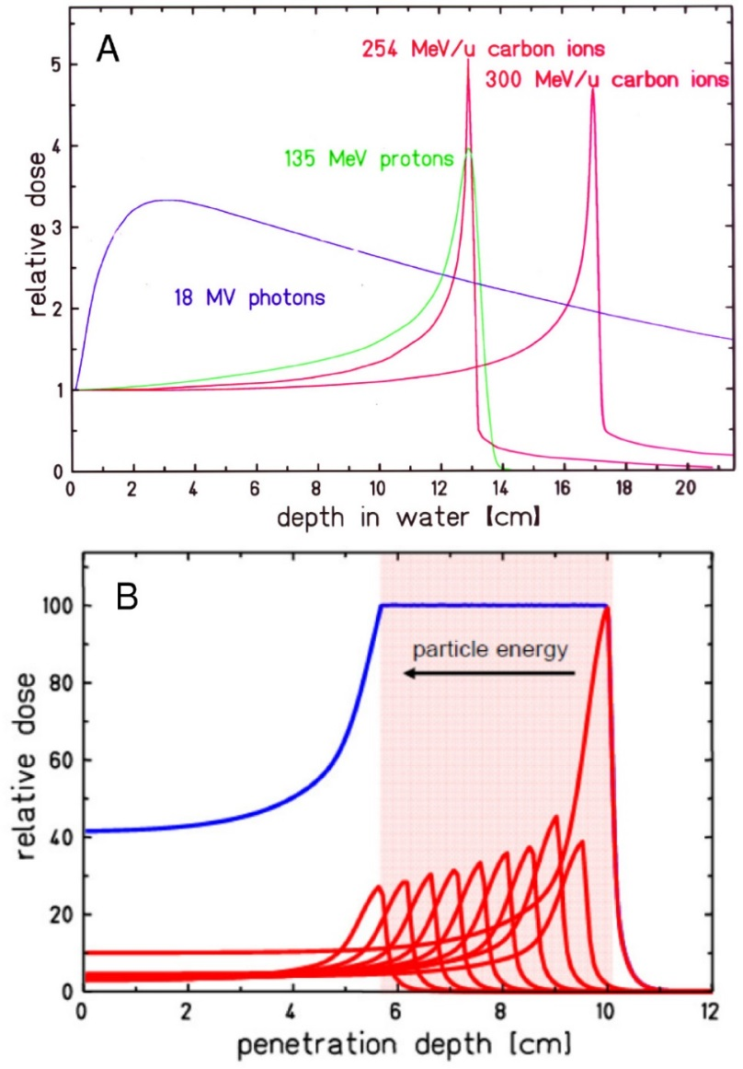
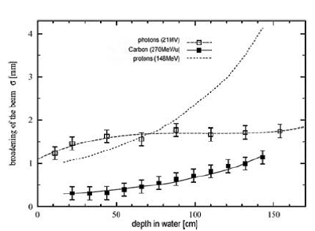
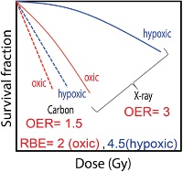
Therapeutic applications of charged particles: hadrontherapy
Physics and radiobiology provide the rationale for medical use of accelerated particle beams
Notes:
Beir2006 Committee on the Biological Effects of lonizing Radiation; a committee of the National Research Council of the USA
All radiation tracks are highly structured on the scale of DNA Spatio-temporally inhomogeneous energy deposition
This is the radiation track video of a 300 MeV 12C6+ ion (LET ∼ 14-15 keV/μm), from ∼10‐12 to ∼10‐6 s.
The left picture is the 3D track; the right picture is the XZ projection of the same track. Each dot
represents radiolytic specie. The changes in color indicate chemical reactions. Iannick Plante.
Asaithamby et al. 2008 radiat res oxygen & silicon 1GeV/n

Slide 14
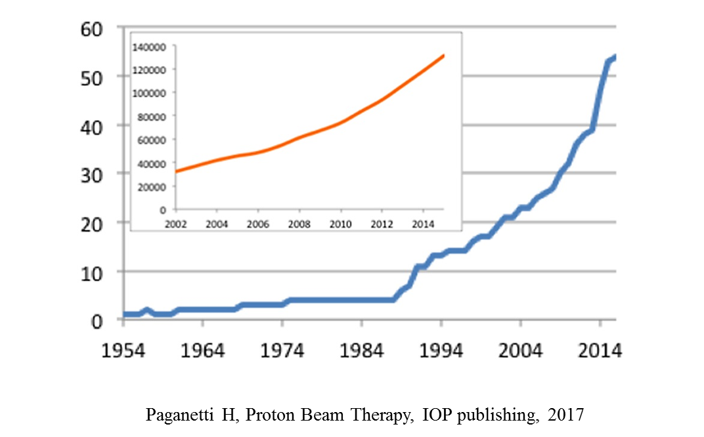
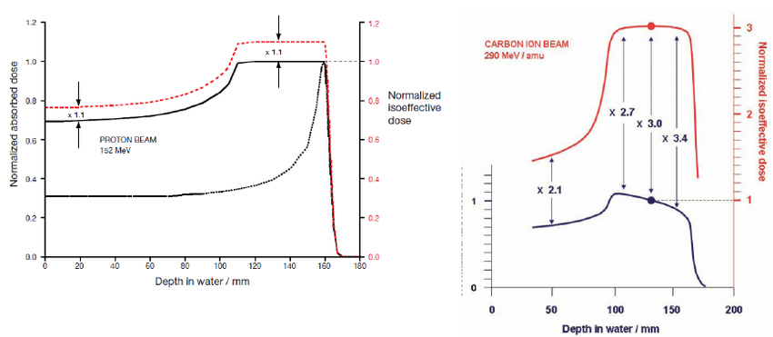
Enhancing protontherapy effectiveness

Slide 15
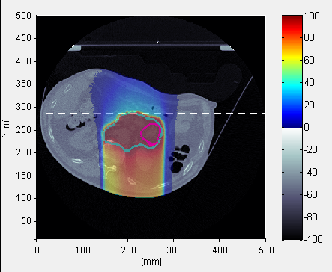
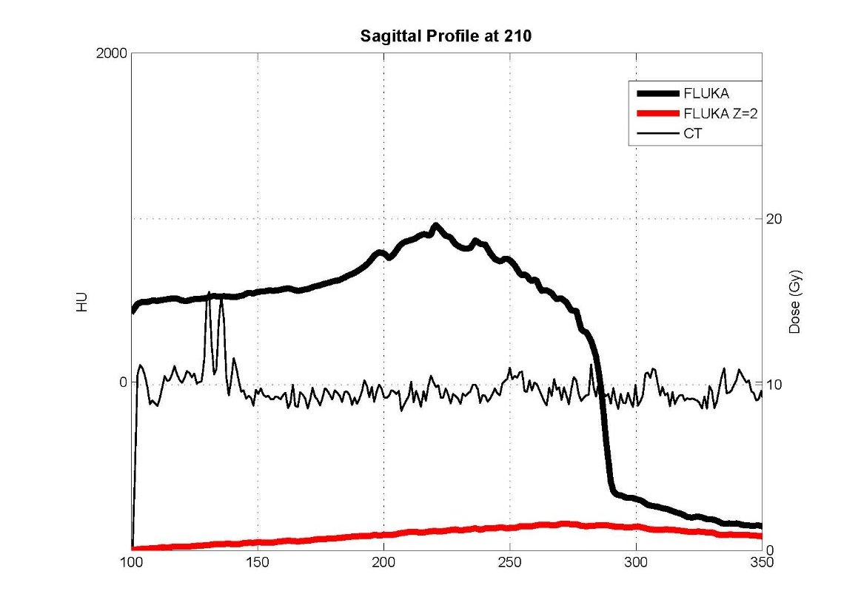
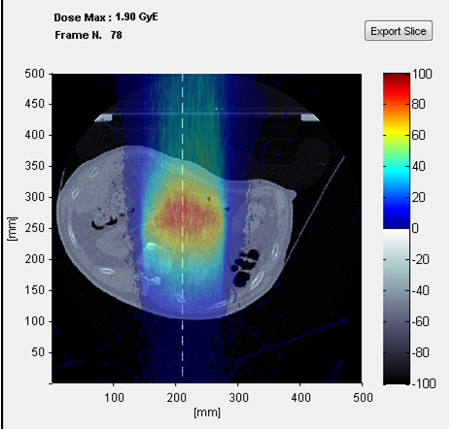
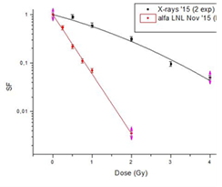
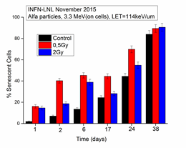
Projectile fragmentation in ¹²C ion hadrontherapy

Slide 16
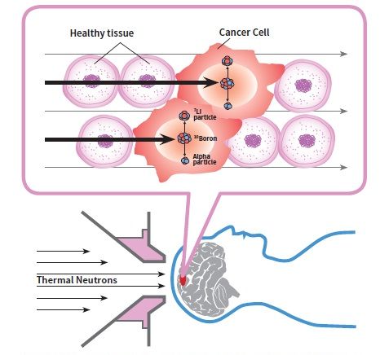
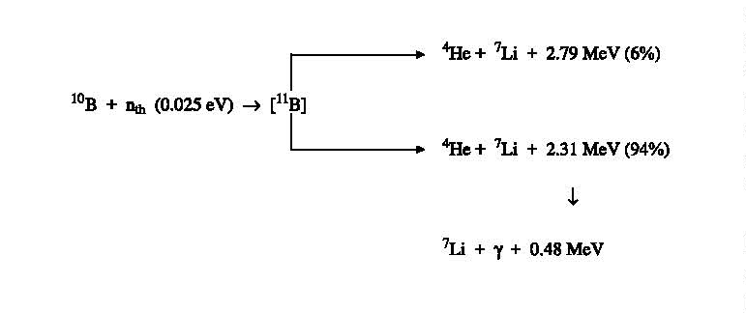
Boron-Neutron Capture Therapy (BNCT)
https://www.nccs.com.sg/Newsroom/NewsArticlesandReports/2015NewsArticlesandReports/Pages/Thenextbigthing.aspx
Notes:
National cancer centre singapore

Slide 17
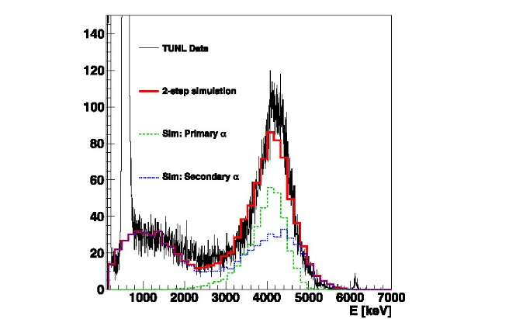
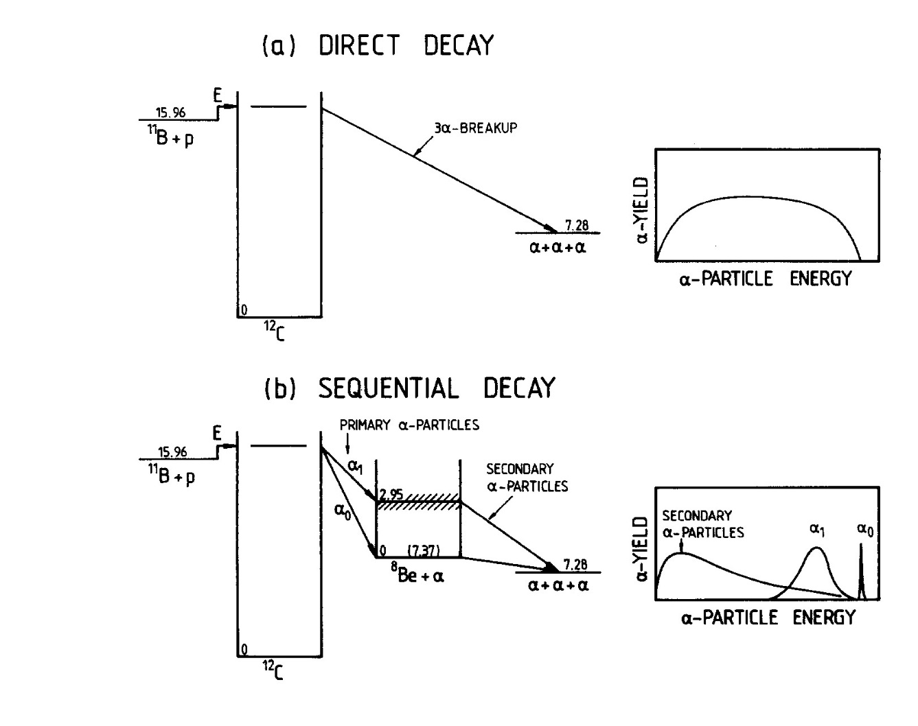
The proton-boron fusion reaction
¹¹B + p → 3α + 8.7 MeV
Stave S. et al., Physics Letters B (2011)
Rolfs C. and Trautvetter H.P. Z. Phys. A - Atomic Nuclei (1987)
Notes:
Expected alpha particle energy specrum of the 11B(p, 3a)reaction for a) Direct breakup b) sequential decay via the ground state and first excited state of 8Be Low-Energy Cross Sections for liB(p, 3e)*
H.W. Becker, Rolfs C. and Trautvetter H.P. Z. Phys. A - Atomic Nuclei 327, 341-355 (1987)

Slide 18
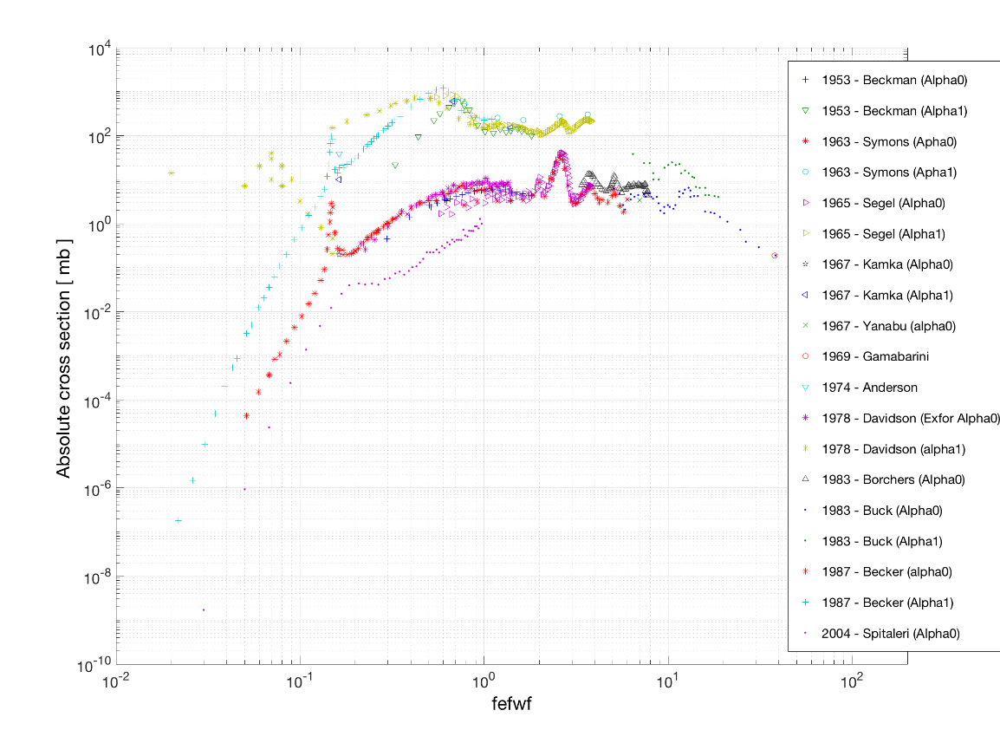
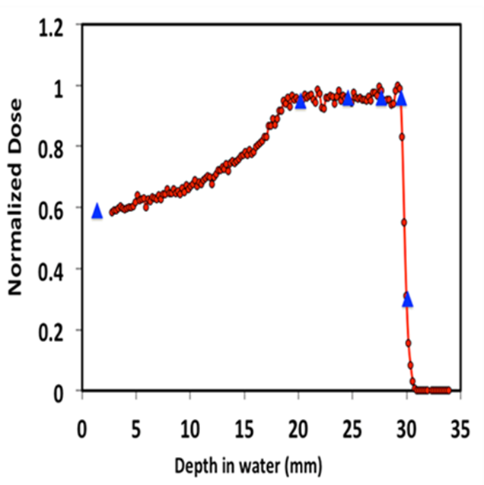
Towards Proton-Boron Capture Therapy (PBCT)-1
Do-Kun, Y. et al., Appl. Phys. Lett. (2014)
Incident proton energy
Courtesy of Cirrone G.A.P., INFN-LNS, Italy
Notes:
Do-Kun, Y. et al.,, Joo-Young, J. & Tae S.S. Application of proton boron fusion reaction to radiation therapy: A Monte Carlo simulation study. Appl. Phys. Lett. 105, 223507 (2014).
The 11B(p, α)αα reaction at the 0.675 MeV resonance

Slide 19
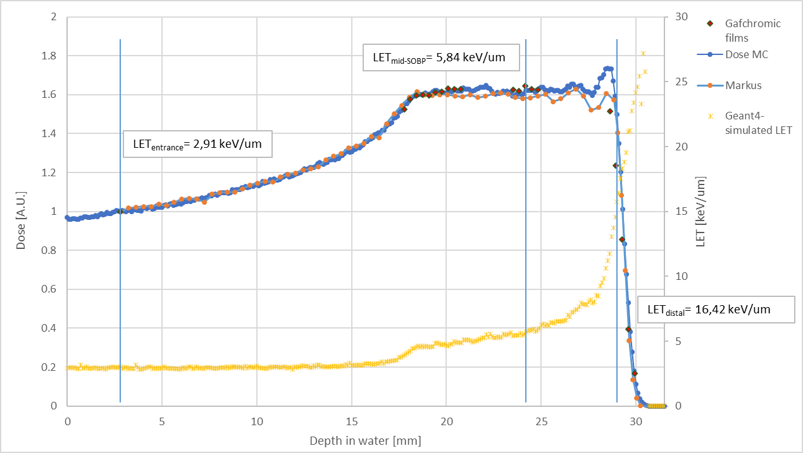
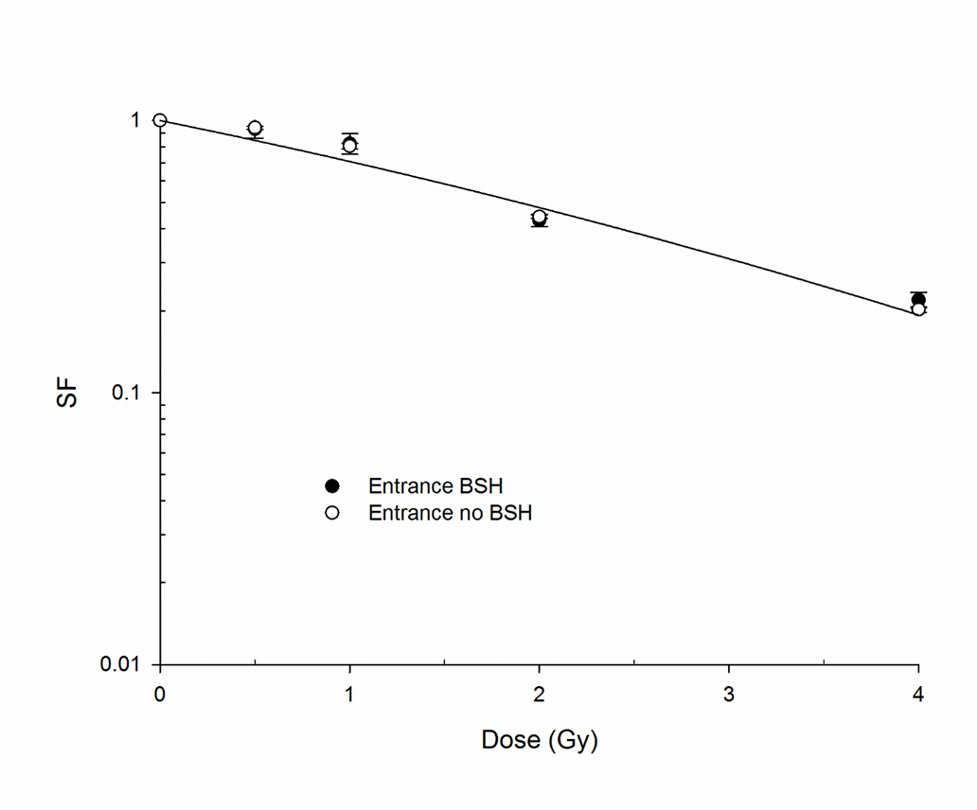
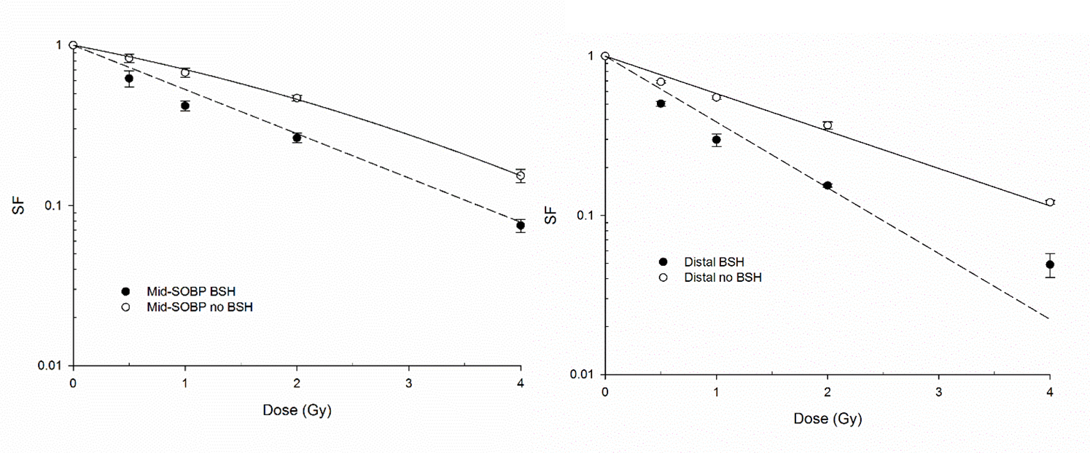
Towards Proton-Boron Capture Therapy (PBCT)-2
DMF₁₀ =1.46 ± 0.12
Cirrone et al., First experimental proof of Proton Boron Capture Therapy (PBCT) to enhance protontherapy effectiveness Sci Rep, in press
Notes:
For x-rays and protons no BSH fitting equation SF=exp(-αD-βB²)
For protons with 40 and 80 ppm ¹¹B fitting equation SF= exp (-αD)

Slide 20
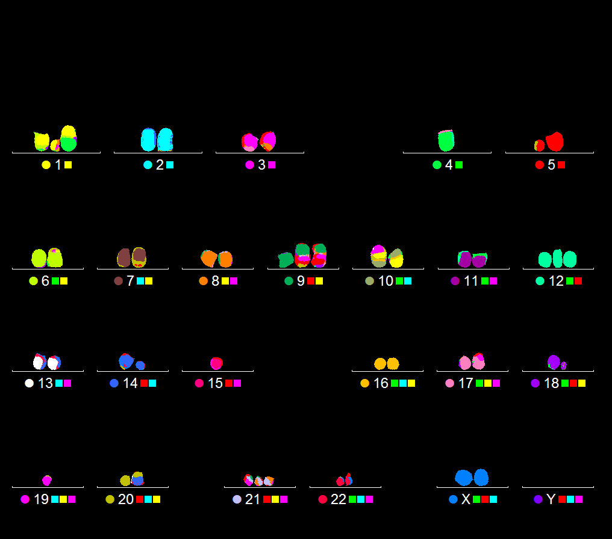
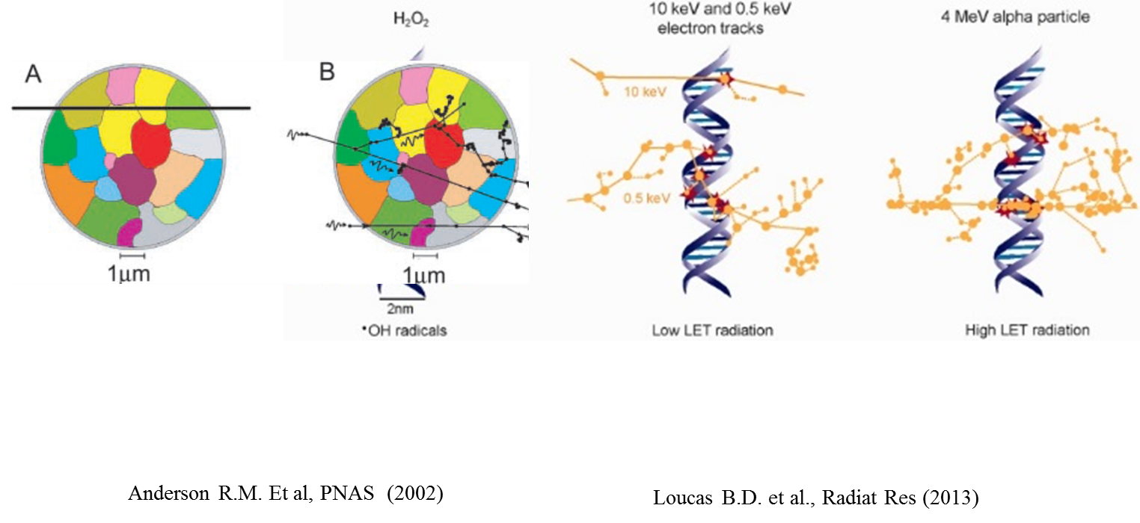
Chromosome aberration studies

Slide 21
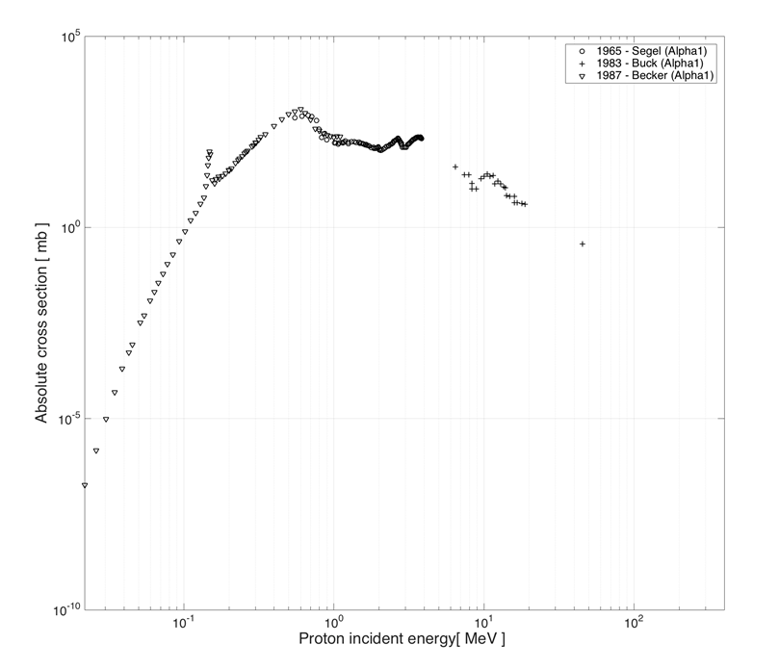
Validation of PBFT
In vitro studies with high-energy clinical beams
In vivo pre-clinical irradiations
Low-energy proton irradiation

Slide 22

Conclusions
Ion radiobiology may still greatly benefit from small accelerators
  Fundamental research on basic radiation action (e.g. role of track structure, cellular repair mechanisms, etc.)
  Clinically relevant applications (e.g. RBE of hadrontherapy-relevant fragmentation products, novel strategies employing nuclear fusion reactions, etc.)

Slide 23


Acknowledgments
“don” Mario Borriello
Luigi Campajola
Annalisa D’Arco
Carla Maiorino
Antonio Minopoli
Rita Massa
Francesca Margaret Perozziello
Giacomo Cuttone
Pablo Cirrone
Giada Petringa
Pietro Pisciotta
Work funded by the grants:
“Effetti delle onde a radiofrequenza UMTS (telefonia cellulare) sulla progenie di cellule umane danneggiate da radiazione ionizzante”in the framework of Legge Regionale n.5 per la Ricerca Scientifica della Regione Campania
MIMO-BRAGG, CSNV INFN

